Slide 1
Creating Custom Metadata Starter
Creating Calculated Fields

Slide 2
Understanding Metadata
Discovery Center collects a wide range of metadata
  Basic metadata comes from the properties of a file
  Extraction rules collect metadata from text contents and other sources
Calculated fields are used to collect metadata and tag files for practical uses such as
  Identifying files for cleansing
  Matching files against records classes
  Highlighting files with potentially sensitive data

Slide 3
MD1 Terminology
Metadata
  Labels which describe the contents, value, purpose and other attributes of a file
  Metadata is added to electronic content as tags to support its management, protection, use or exploitation
Calculated fields
  Discovery Center extracts and stores metadata in calculated fields
  Each calculated field is named to match a metadata attribute
  Fields may be used to report on content or tag file migrated to a suitable repository
Extraction rules
  Extraction rules define how Discovery Center extracts metadata values from a file or repository
  The results from extraction rules are written into calculated fields for storage and re-use

Slide 4
MD1 Key Concepts: Rules and Fields
Extraction rules extract values from files
  Five rule types provide strategies for identifying characteristics of files
  Rules are configured prior to indexing
  Extraction rules populate calculated fields with one or more metadata values
Calculated fields
  Store the values gathered by extraction rules for later use
  Calculated fields are for reporting or as metadata to support migration
Index configurations
  Re-usable configurations control how indexes behave and what fields to apply
  Calculated fields are added to index configurations
Start
Extraction Rule(s)
Calculated Field
Index Configuration
Index
Finish

Slide 5
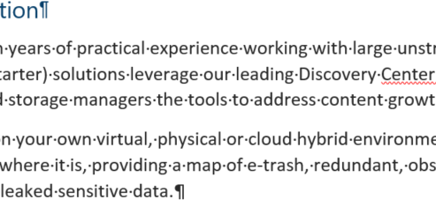
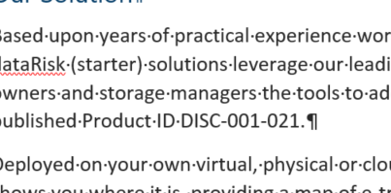

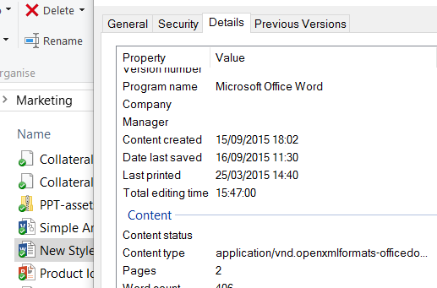
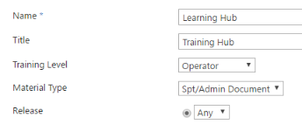
MD1 Key Concepts: Extraction Rule Types
Keyword match
  Find words within file text contents
Content pattern match
  Find precise patterns of characters in file text contents
File path pattern match
  Finds precise patterns of characters in file path text
Embedded file properties
  Extracts metadata embedded in file headers
  Includes Microsoft Office and JPEG EXIF properties
Repository property
  Captures values from metadata in a repository such as SharePoint
Keyword
Content pattern
File path pattern
Embedded properties
Repository properties

Slide 6
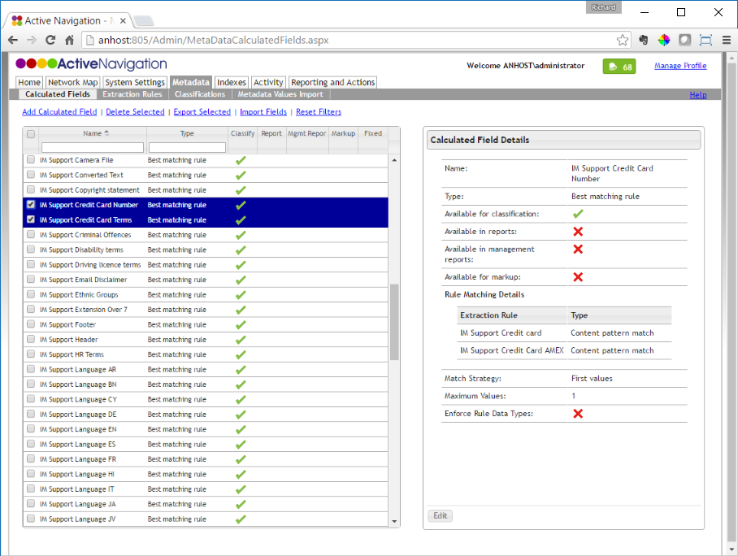
MD1 Exporting and Importing Field and Rules
Fields and rules can be passed between Discovery Centers using import and export features
Fields are exported with their associated extraction rules
Go to Metadata > Calculated Fields
  Use the checkboxes to select fields for export
  Click Export Selected
  An xml file will be saved to the browser download location
  It is good practice to rename the file to describe its contained rules
To import, click Import Fields and follow the dialog prompts

Slide 7
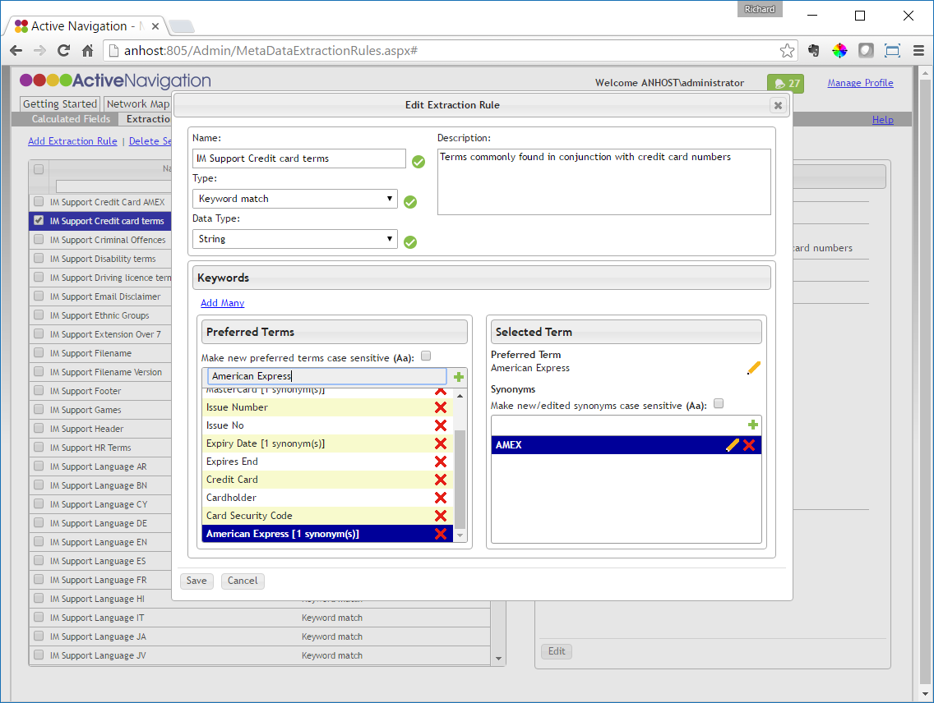
MD1 Create a Keyword Extraction Rule
Go to Metadata > Extraction Rules
Click Add Extraction Rule
  Enter a name for the extraction rule
  Select Keyword match rule type
  Select String data type
Add a preferred term and synonyms
  Enter a keyword in the Preferred Terms text box
  Press Enter or click + to add the term
  Enter a synonym in the Selected Term synonym text box
  Press Enter or click + to add the term
  Repeat until all terms and synonyms are added
Click Save

Slide 8
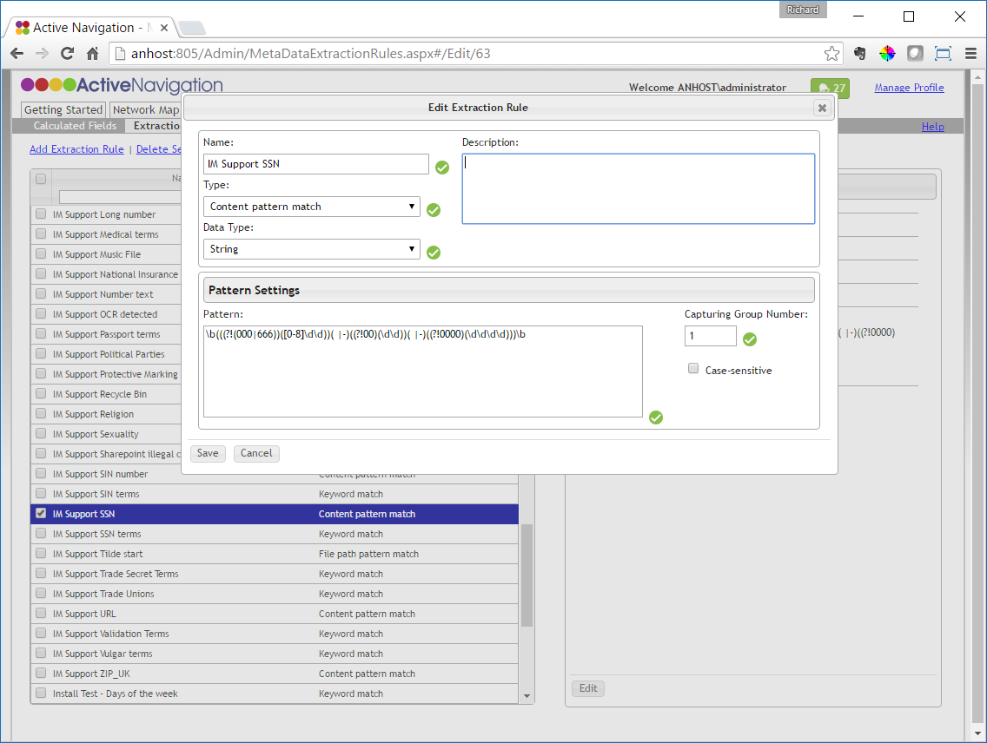
MD1 Create a Pattern Match Rule
Go to Metadata > Extraction Rules
Click Add Extraction Rule
Enter a name for the extraction rule
Choose a File Path or Content Pattern Match rule type
Select the String data type
In the Pattern Settings options
  Enter the required regular expression into the Pattern text box
  Ensure the Capturing Group Number is set appropriately
  Set the Case sensitive checkbox as needed
Click Save

Slide 9
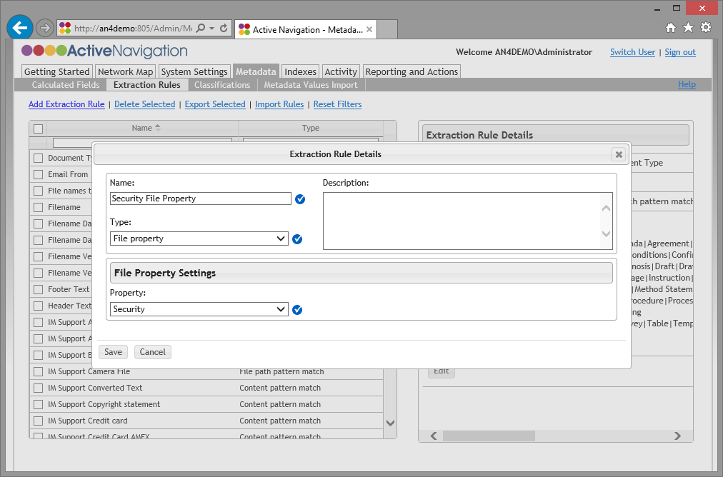
MD1 Create File Property Rule
Go to Metadata > Extraction Rules
Click Add Extraction Rule
Enter a name for the extraction rule
Choose a File property rule type
From the File Property Settings pick the property you wish to capture
Click Save

Slide 10
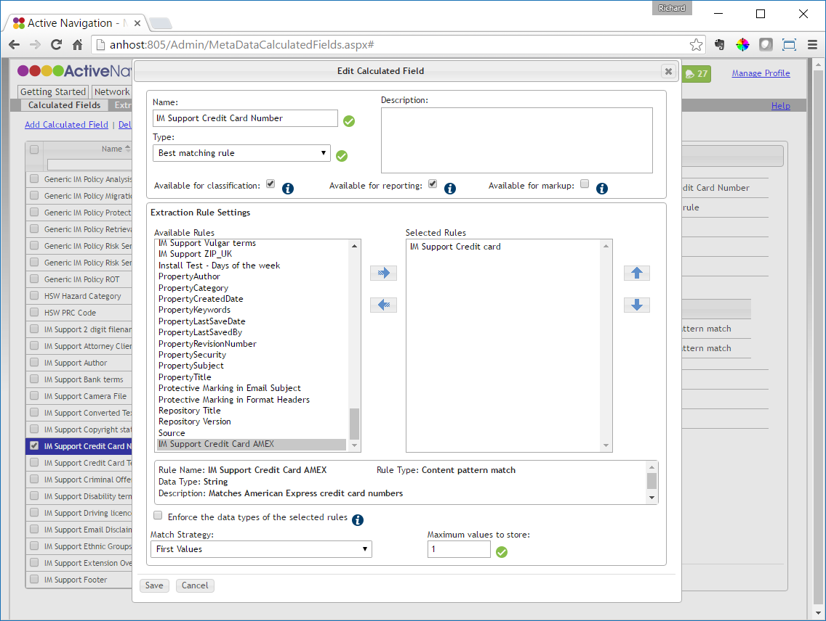
MD1 Create a Field for Extraction Rules
Go to Metadata > Calculated Fields
Click Add Calculated Field
Enter a name for the calculated field
Select Best matching rule field type
Apply checkbox options
  Check Available for classification
  Check Available for reporting
  Uncheck Available for markup
Add extraction rules
  Select rules from the Available Rules list
  Click ⇨ to add the rules to Selected Rules
Choose a Match Strategy
  Select First Values
  Enter the number of values to be stored
Click Save

Slide 11
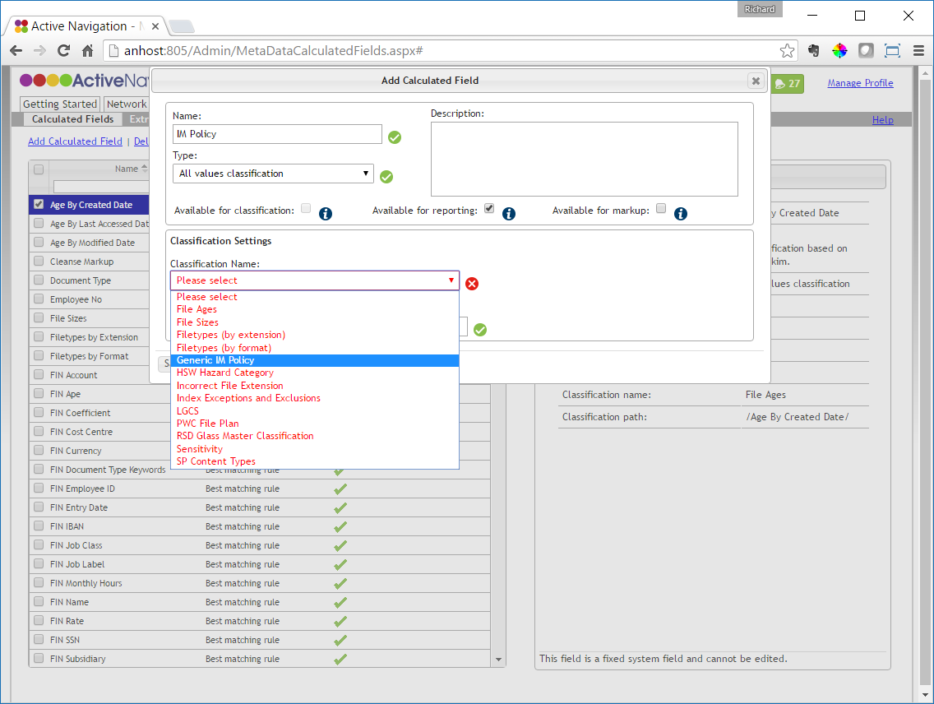
MD2 Deploy a Classification
Open Discovery Center and click Metadata > Calculated Fields
Click Add Calculated Field
  Enter a field name
  Choose the field Type All values classification
  Select the Available for reporting checkbox
  Select the required classification from the Classifications Settings
Click Save
Add the new calculated field to an index configuration (see MD1)

Slide 12
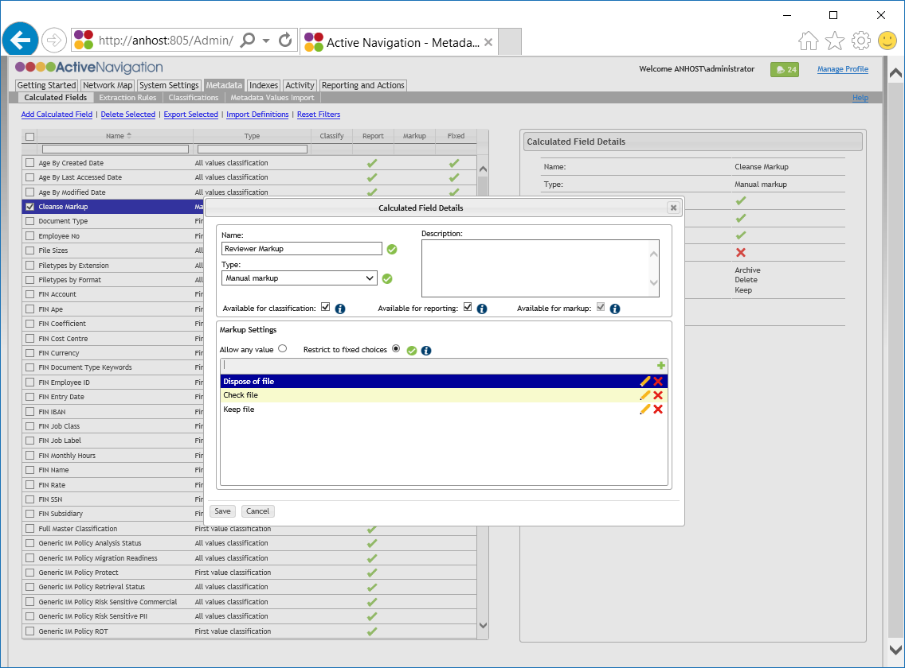
AC4 Set Up a Markup Field
Go to Metadata > Calculated fields
Click Add Calculated Field
Give the field a meaningful name
Click on the Type dropdown and select Manual Markup
Select Restrict to fixed choices
Enter the first markup value choice and hit Enter or click on the + icon
Add additional choices as needed
Choices can be edited as needed
Click Save

