Slide 1
Information Manager Starter
Working with Reports and Actions

Slide 2
Process and Role Overview
Information Manager undertakes and manages:
  Reports and saved views
  Actions on report views
  Review by users in the Reviewer role
Reports are generated from Discovery Center indexing and analysis
The Information Manager prepares and explores report views
The Information Manager can action reports as needed
The Information Manager can assign other users to work with report views
The Information Manager can issue work packages for review
System Configuration
Indexing: Skim
Report Review and Action
Roles
System Admin
Indexing: Duplication
Report Review and Action
Active Navigation Admin
Indexing: Analysis
Report Review and Action
Information Manager
File Metadata Import
File Metadata Review and Update
Reviewer

Slide 3
Working with Reports
Discovery Center indexing rapidly skims and inventories files
Work with your Active Navigation Administrator to have files skimmed and classified for your review and action
Skim results allow the full range of basic metadata to be reviewed and acted upon
Focus on skim results in order to efficiently address large volumes of content

Slide 4
RP1 Key Concepts 1
Available report types are:
  File extensions
  File dates (created, modified and last accessed)
  File owner (from repository Windows Owner attribute)
  Containers (folder structure, file volumes and file counts)
  Duplicates
  Calculated field (for available fields such as Sensitive Data)
Reports across millions of files will take time to render
  Report views are cached for subsequent fast rendering
Reports show a snapshot of index results at a given time
Areas of Interest allow results from different indexes and locations to be combined into one report

Slide 5
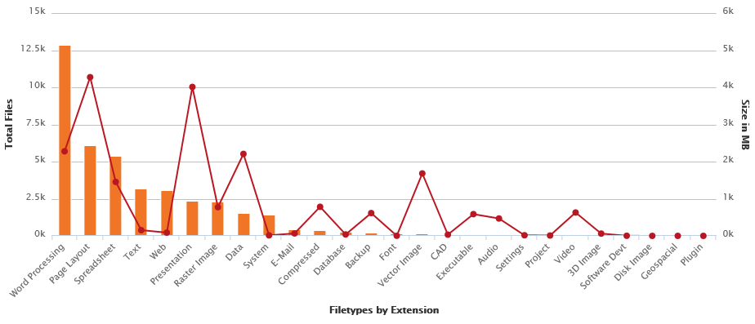
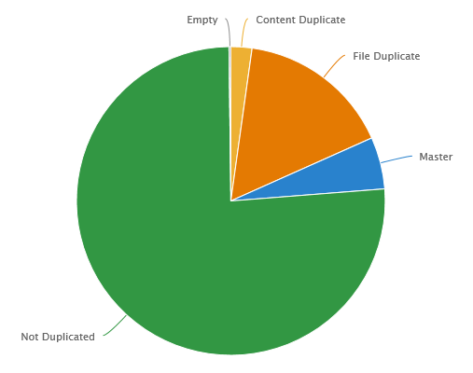
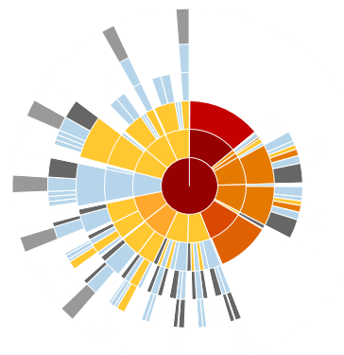
RP1 Key Concepts 2
Chart presentations are chosen to best represent index results
  Column charts for basic metadata and calculated fields
  Pie charts for duplicates
  Radial maps for containers and folders
All reports are actionable
  Delete/quarantine
  Migrate
  Markup
  Update metadata
  Export

Slide 6
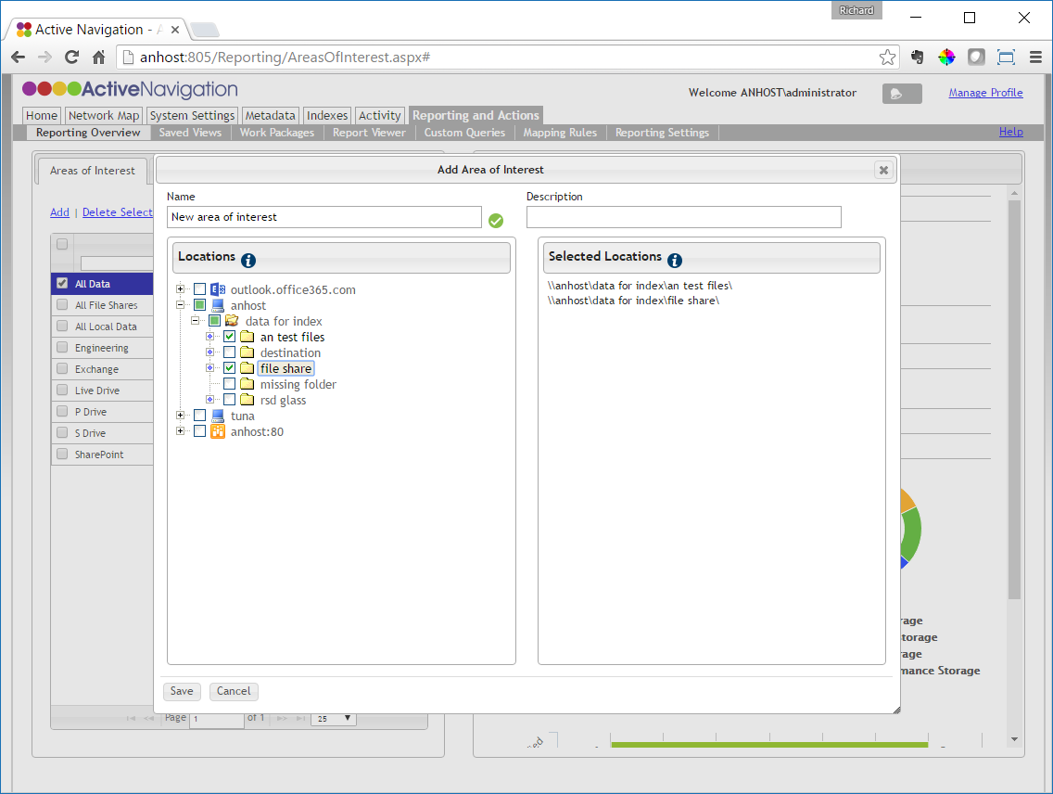
RP1 Add an Area of Interest
Go to Reporting and Actions > Reporting Overview
Click on the Area of Interest tab
  Click Add
  Enter a descriptive name
Check the locations that you need to add to the area of interest
  Any location can be added
  Added locations will be listed on the right
Click Save

Slide 7
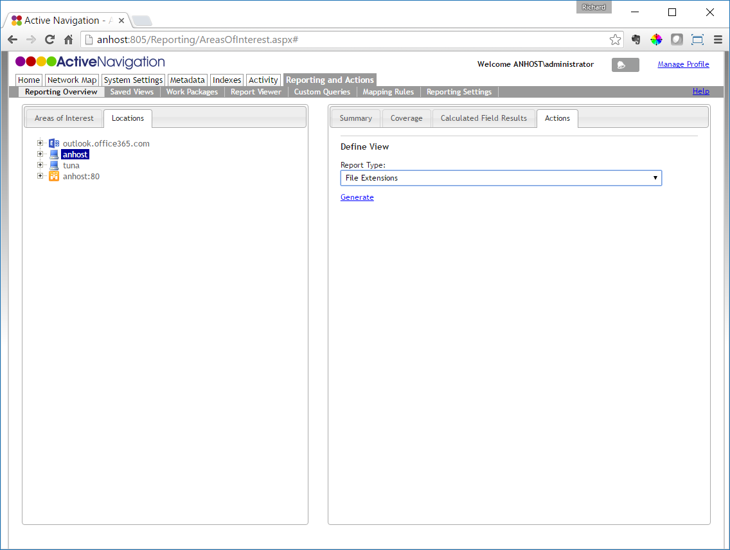
RP1 Generate a Report
Go to Reporting and Actions > Report Overview
Click the Locations tab then click on an Area of Interest or a location on the Network Map
Click Actions
From the Report Type drop down, click File Extensions
Click the Generate link

Slide 8
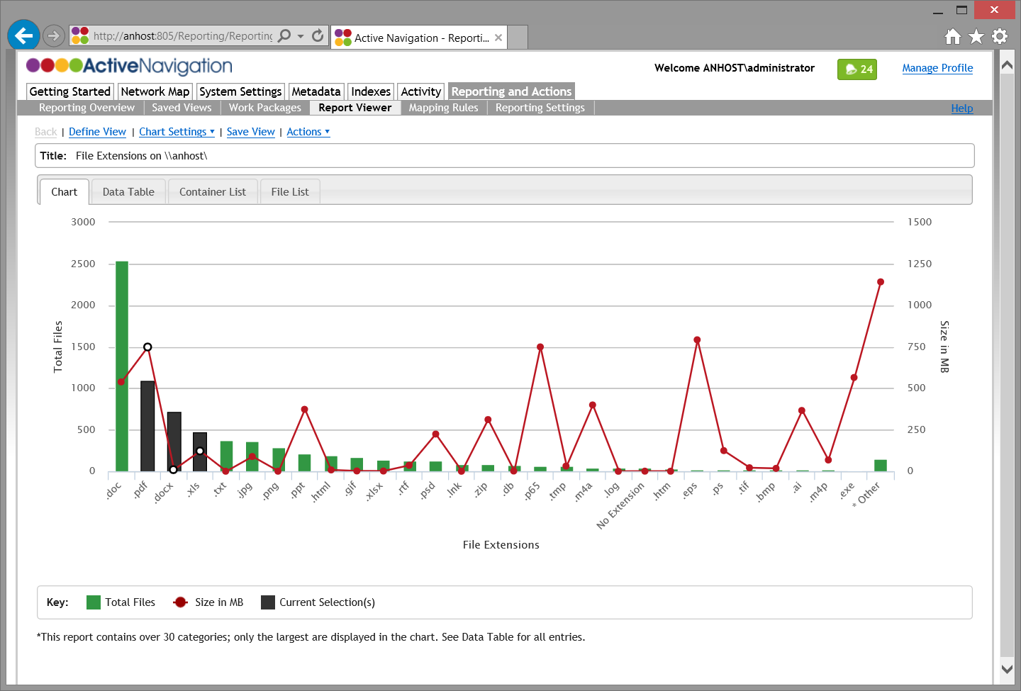
RP1 Explore a Report Chart
Once a report chart has been generated, its features can be explored
Chart columns show the number of files with a given value
The red line shows the total size of files
Charts will limit the number of values presented to remain usable
Click on columns to select values of interest
Ctrl-click enables many columns to be selected at once

Slide 9
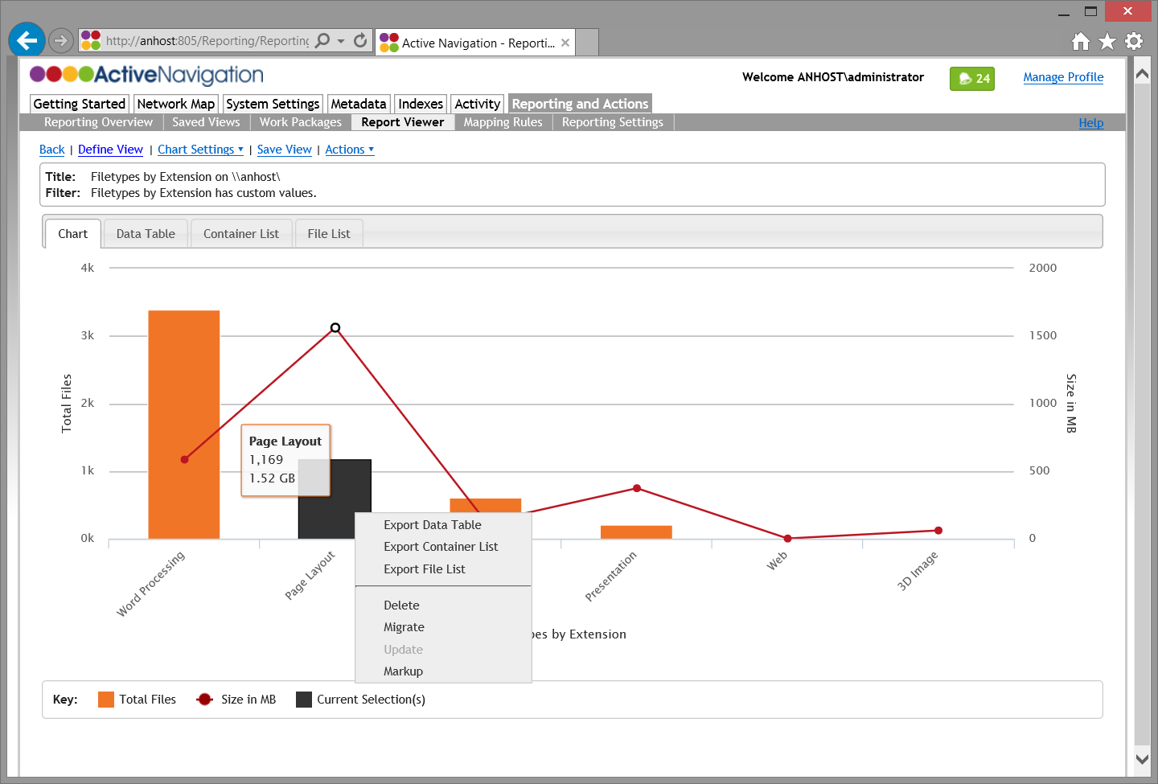
RP3 Close Look at a Report Chart
Filter details
Report title provides chart context
Context menu works with selected value
Chart columns show file count
Chart line shows file size
Values can be selected
Report categories or values
Report Type

Slide 10
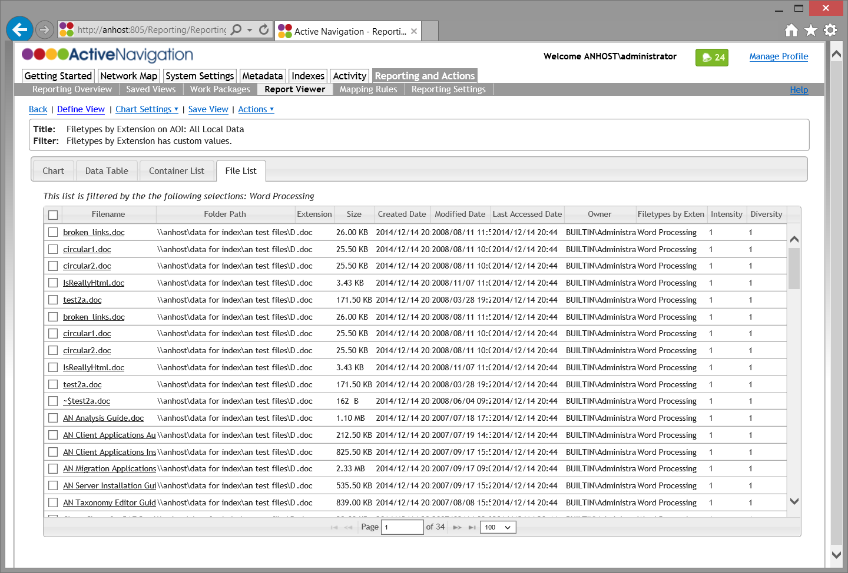
RP3 Close Look at a File List
File list responds to chart and data table selections
All lists contain common core columns
Check box selects files for action
Right-hand columns change based upon report type
Click file name for file details
Lists are paged and sorted by relevance
Lists can contain up to a million files

Slide 11
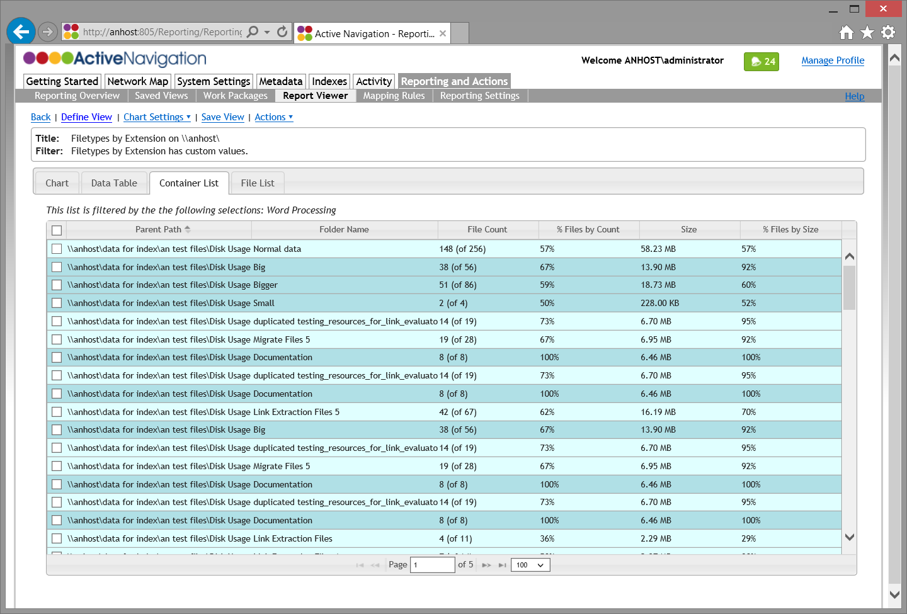
RP3 Close Look at a Container List
Containers are listed only for the selected files categories
Statistics show how many of the chosen files are in each container
Child containers are grouped under their parent
The immediate parent container is shown to help review

Slide 12
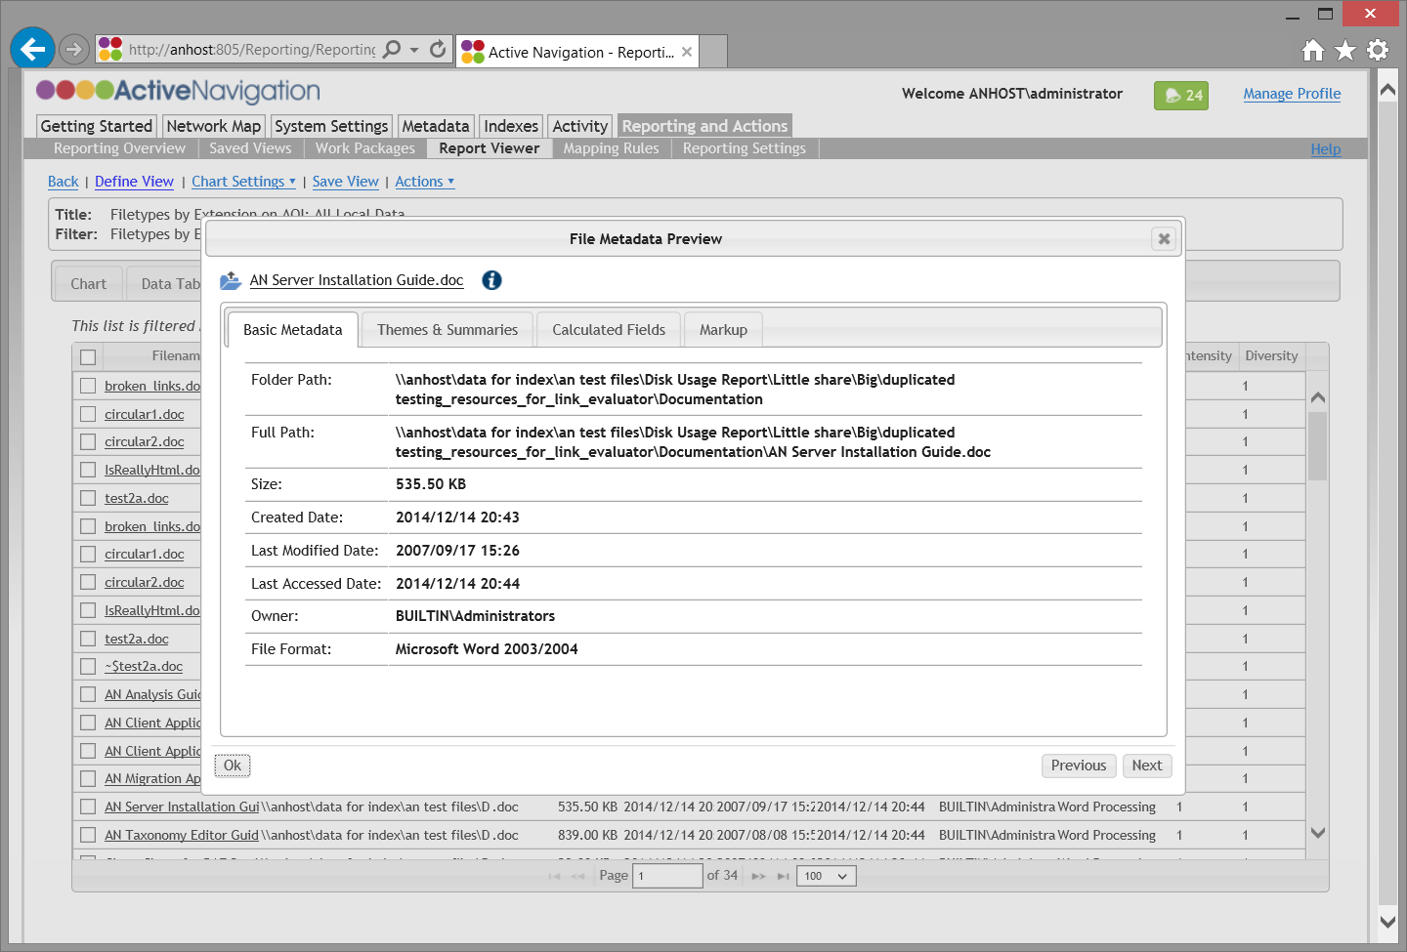
RP3 Close Look at a Metadata Preview
Link opens file if the browser in use has the right permissions
Different types of metadata are grouped together in tabs
Full and patent paths can be copied as links
Page through the file list to review files in turn

Slide 13
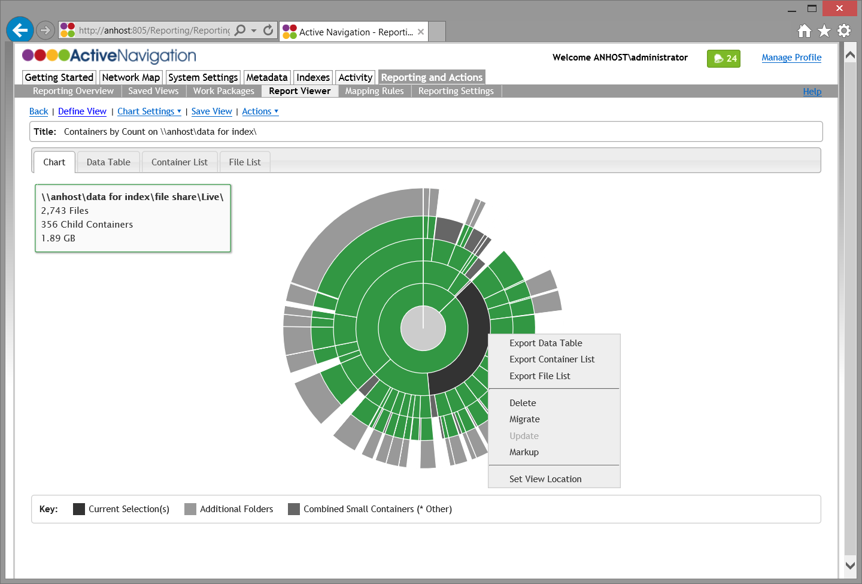
RP3 Simple Container Reports
Grey inner segments shows where small containers have been rolled up
Grey outer ring shows where more files lie
Mouse over a container to see detailed data
Select and right-click to access context menu
Container size shows relative file counts or volumes
Set view location re-focuses the chart

Slide 14
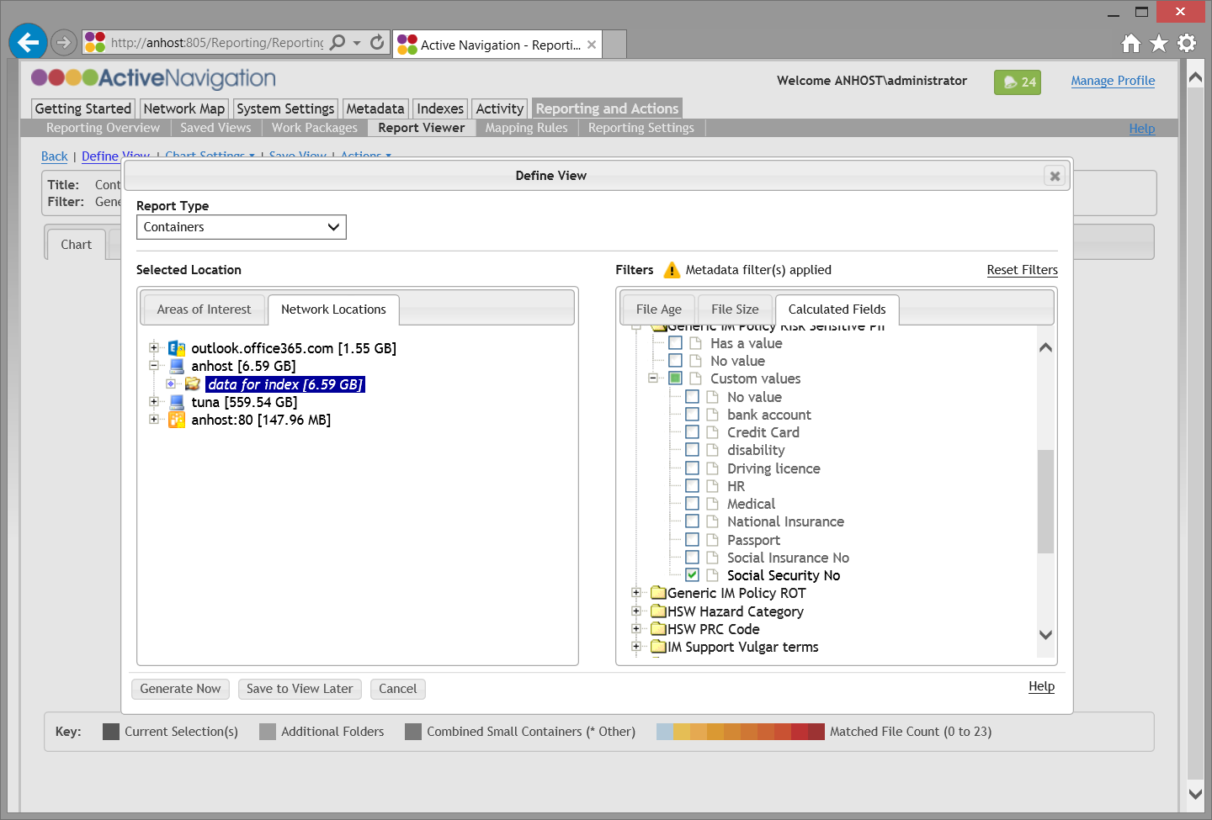
RP3 Filtered Container Report 1
Click Define View
Choose a Report Type and a Network Location
Click on a filter tab (File Age, File Size or Calculated Fields)
Choose the filter values you require
  Use age to locate old files
  Use size to locate large files
  Use calculated fields to locate files with specific metadata
Click Generate Now

Slide 15
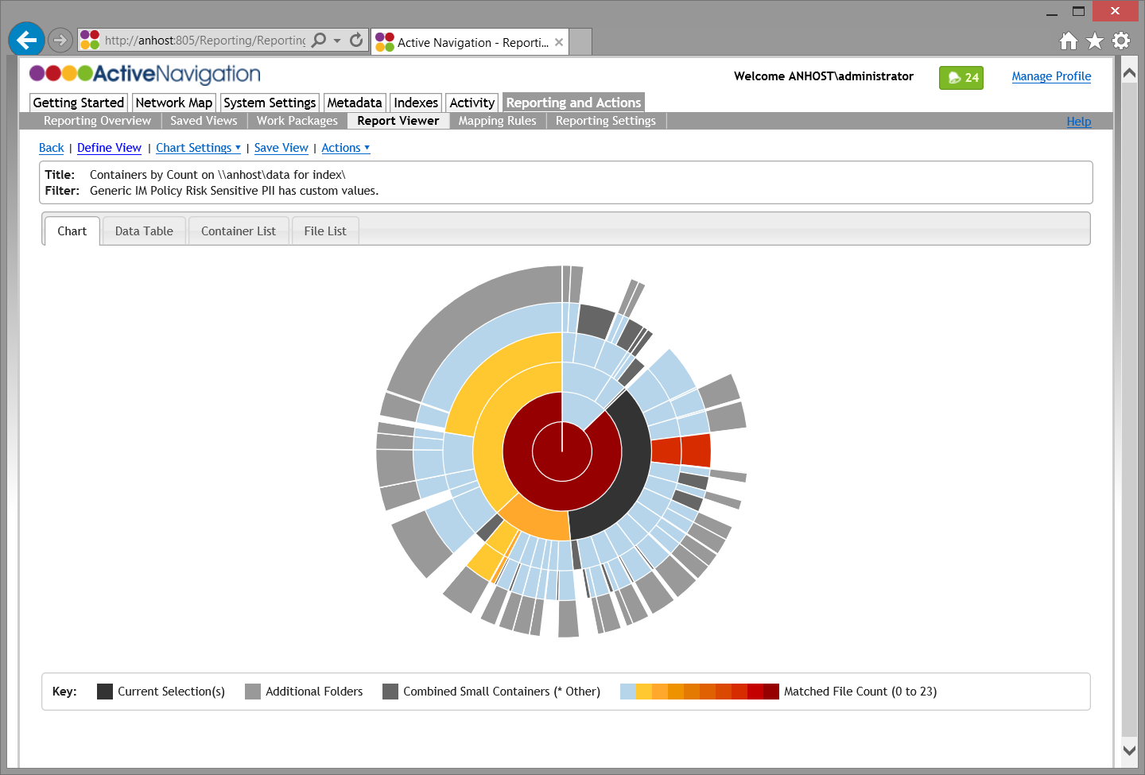
RP3 Filtered Container Report 2
Blue containers contain no matching files
Select containers to view file and container list
Shows heat based upon selected filters
Colors shows which locations contain the files responding to the filter
Parent location inherits heat from its children

Slide 16
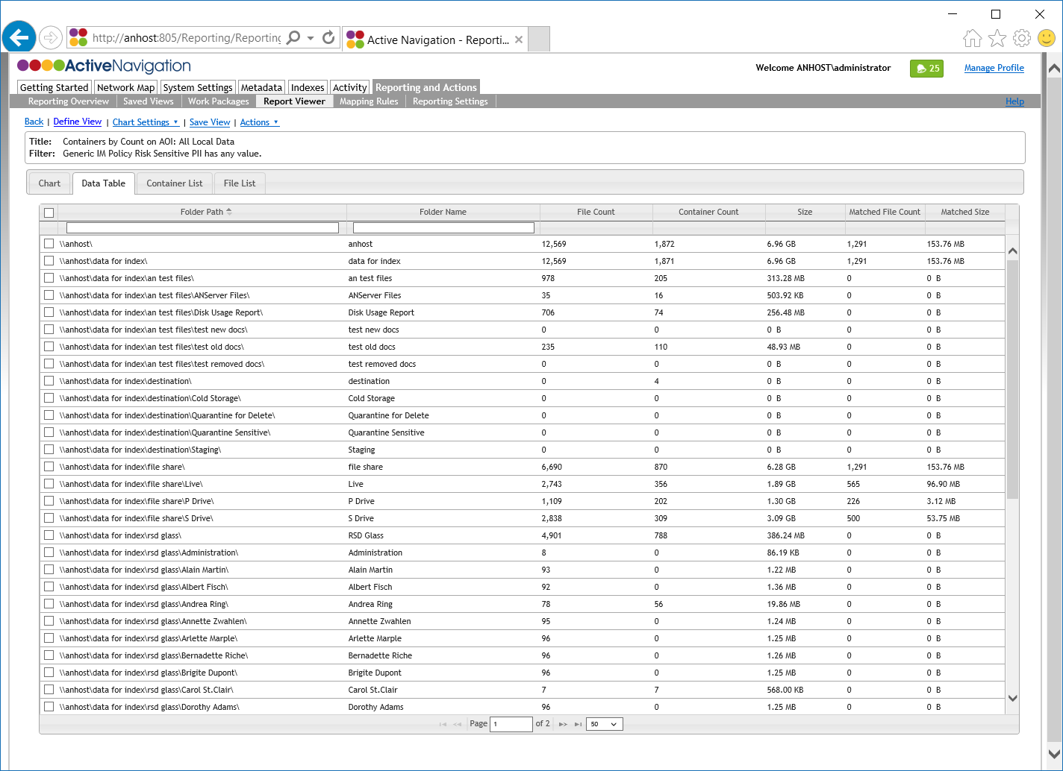
RP3 Container Report Review
Click Data Table to view a list of containers
Entries with a Matched File Count contain items that match your filters
If File Count and Matched File Count are the same then all files in the container match the filters
Use this feature to identify, for example, containers where all files are stale/unmodified since a given date

Slide 17
Delete and Migration Actions
Deletion and quarantine removes unwanted files from storage
Quarantine provides an alternative to deletion
  Quarantine allows for removal of files without deletion
  Files in quarantine locations can be cleaned up at a later date
Markup allows files to be tagged to reflect a disposal decision so they can be acted on later

Slide 18
AC2 Key Concepts
Reports views are used to filter and select files for deletion or quarantine
Files can be acted upon one-by-one or in bulk
File deletion is permanent unless a quarantine location is chosen
Discovery Center performs checks to ensure that failed actions do not result in lost files
  If any part of a file action fails the action is aborted before the file is acted upon
Shortcut creation is provided for duplicate file cleansing and file migration

Slide 19
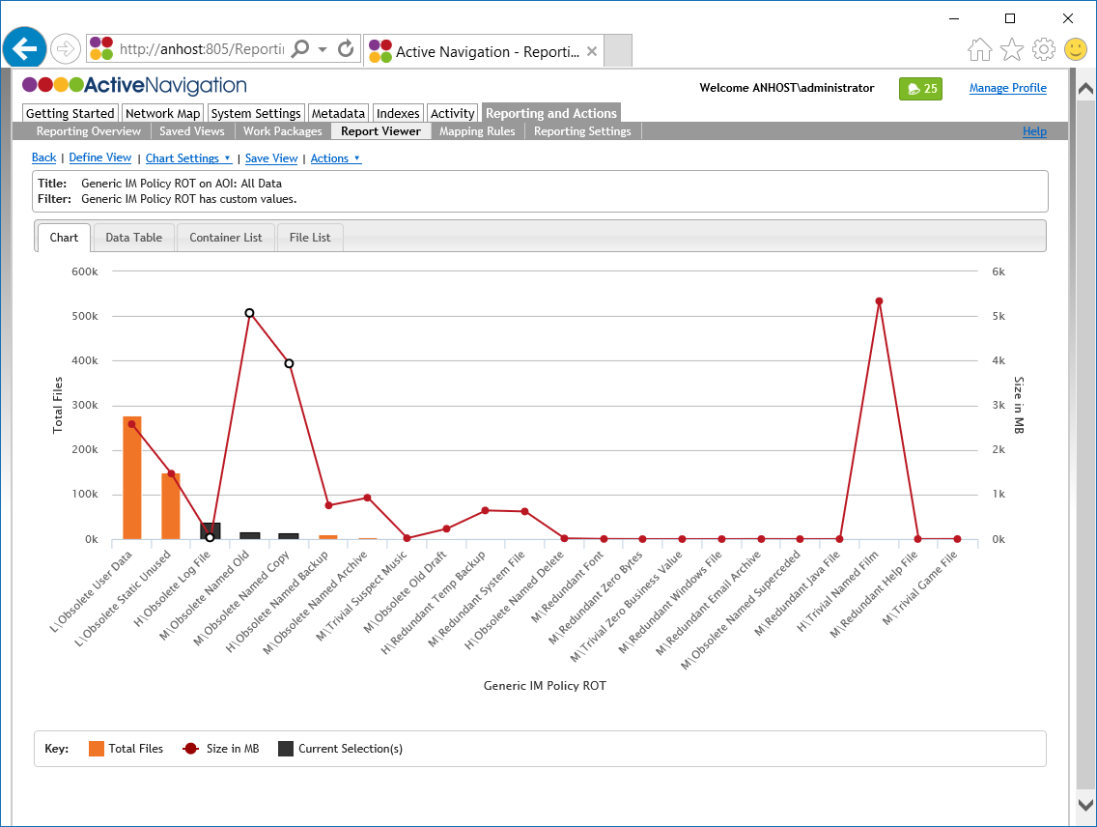
AC2 Select Files for Deletion
Create a report view that identifies the files for deletion
  Files for deletion may be contained in one or more report values
  Click the Data Table tab to view a list of values if you prefer
Select the values for deletion
  Use click and shift-click to select the chart columns
  On the Data Table select the check boxes

Slide 20
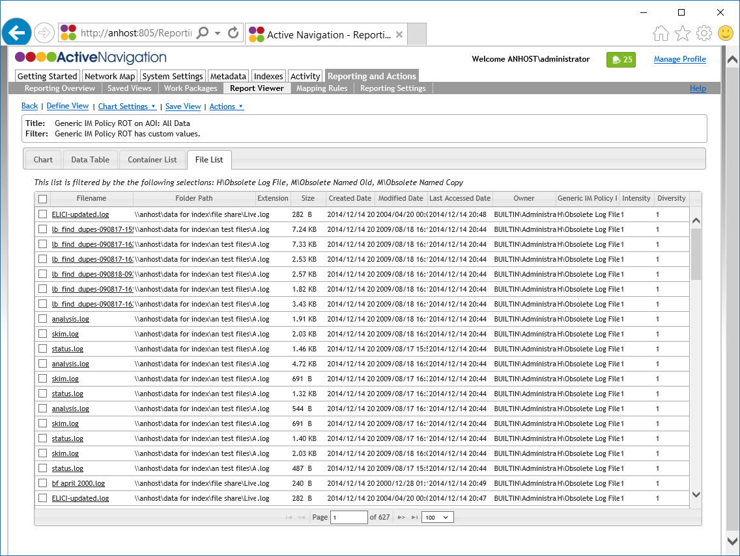
AC2 Confirm Files for Deletion
Click the File List tab to review selected files
  The File List shows only files in the selected chart columns
  Check that you understand which files have been selected
Click on a Filename to view the file metadata if necessary

Slide 21
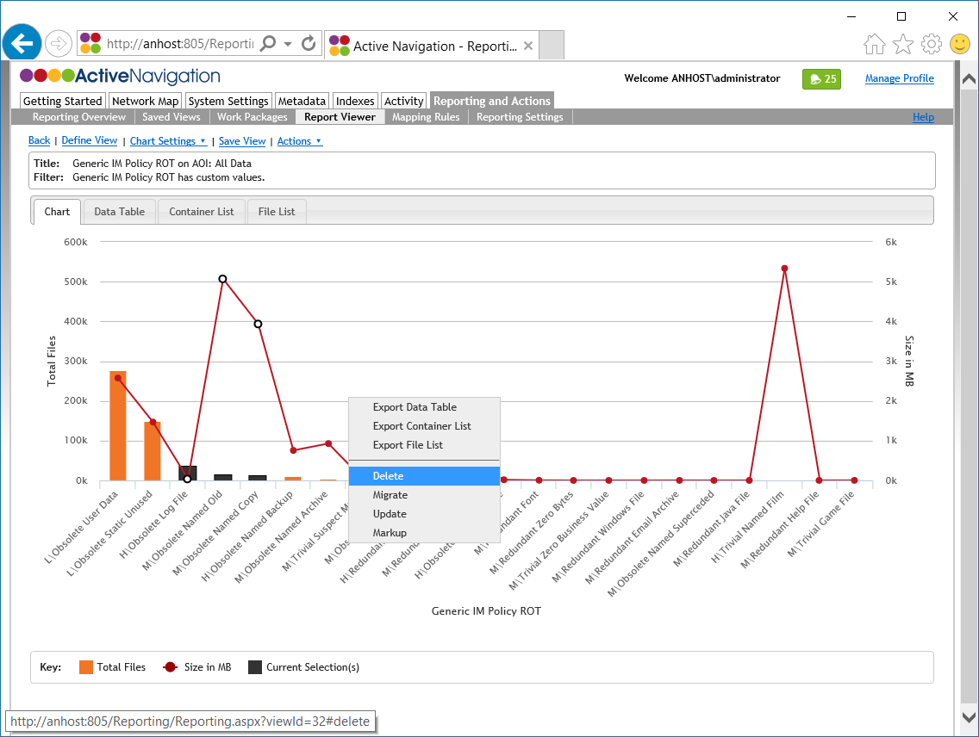
AC2 Delete Files 1
Click on the Chart tab
Confirm the correct chart values are selected
Right-click on the chart area
Click on the Delete option

Slide 22
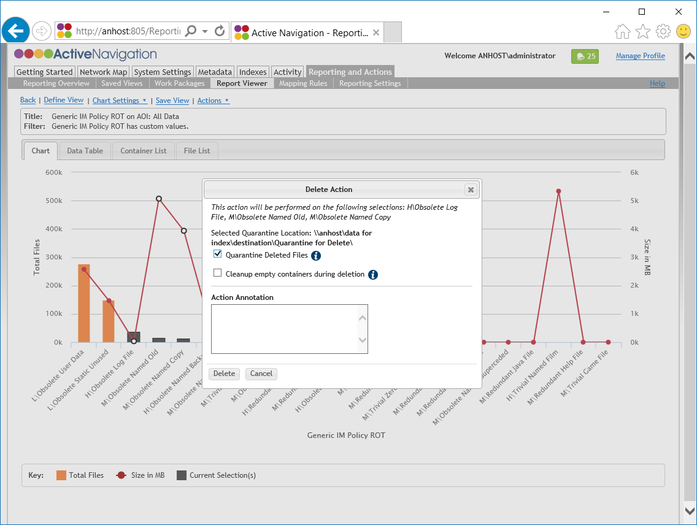
AC2 Delete Files 2
A dialog box will offer options for the delete action
To move files to quarantine instead of deleting
  Confirm the Quarantine Location details are correct
  Check the Quarantine Deleted Files checkbox
To delete the files, ensure Quarantine Deleted Files is unchecked
Click Delete
A confirmation box will appear. Check its details and click OK if they are correct

Slide 23
AC3 Key Concepts
Reports are used to filer and select files for migration
Files can be migrated one-by-one or in bulk
A wide range of options are available for the creation of folder structures at the destination
Active Navigation performs checks to ensure that failed actions do not result in lost files
  If any part of a file action fails the action is aborted before the file is acted upon

Slide 24
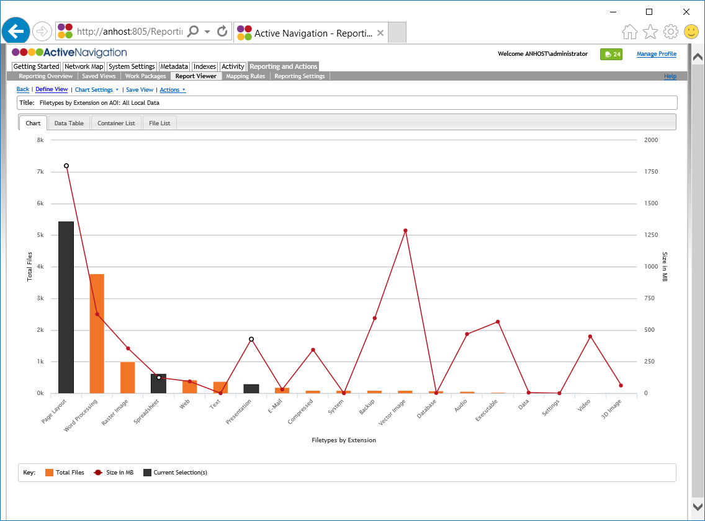
AC3 Select Files for Migration
Create a report view that identifies the files for migration
  File may be contained in one column or several columns
  Click the Data Table tab to view a list of values if you prefer
Select the categories for migration
  Use click and shift-click to select the chart columns
  On the Data Table select the check boxes

Slide 25
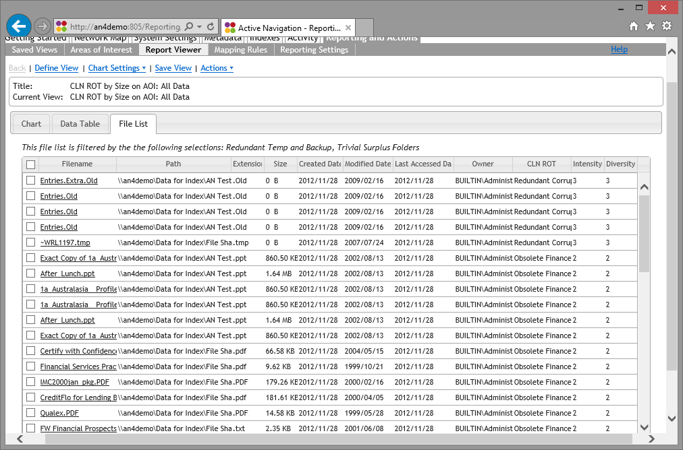
AC3 Confirm Files for Migration
Click the File List tab to review the files
  The File List shows only files in the selected chart columns
  Check that you understand which files have been selected
Click on a Filename to view the file metadata if necessary

Slide 26
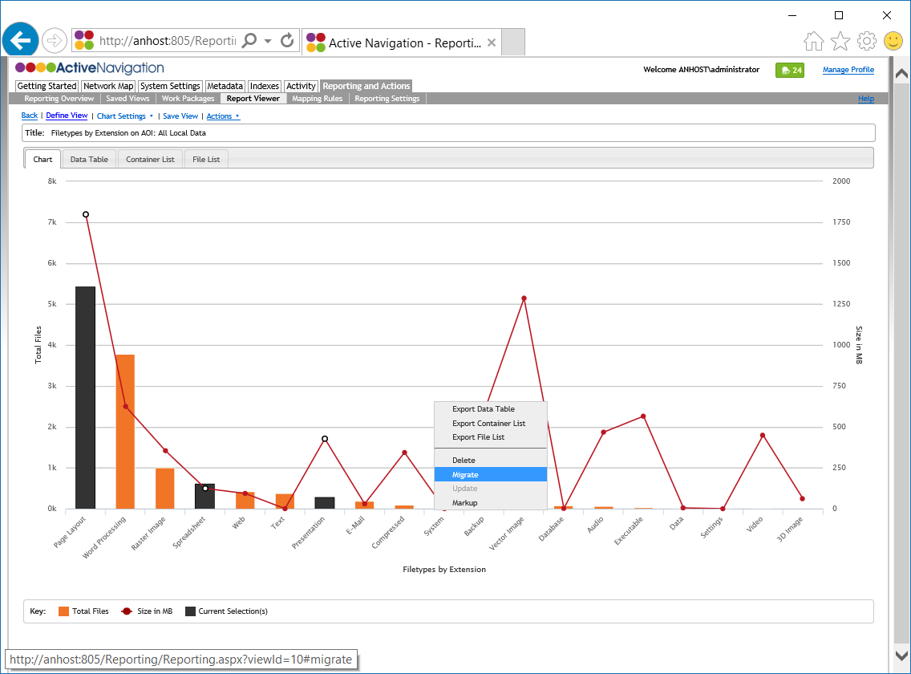
AC3 Migrate Files 1
Click on the Chart tab
Confirm the correct chart categories are selected
Right-click on the chart area
Click on the Migrate option
A dialog box will offer options for the migrate action

Slide 27
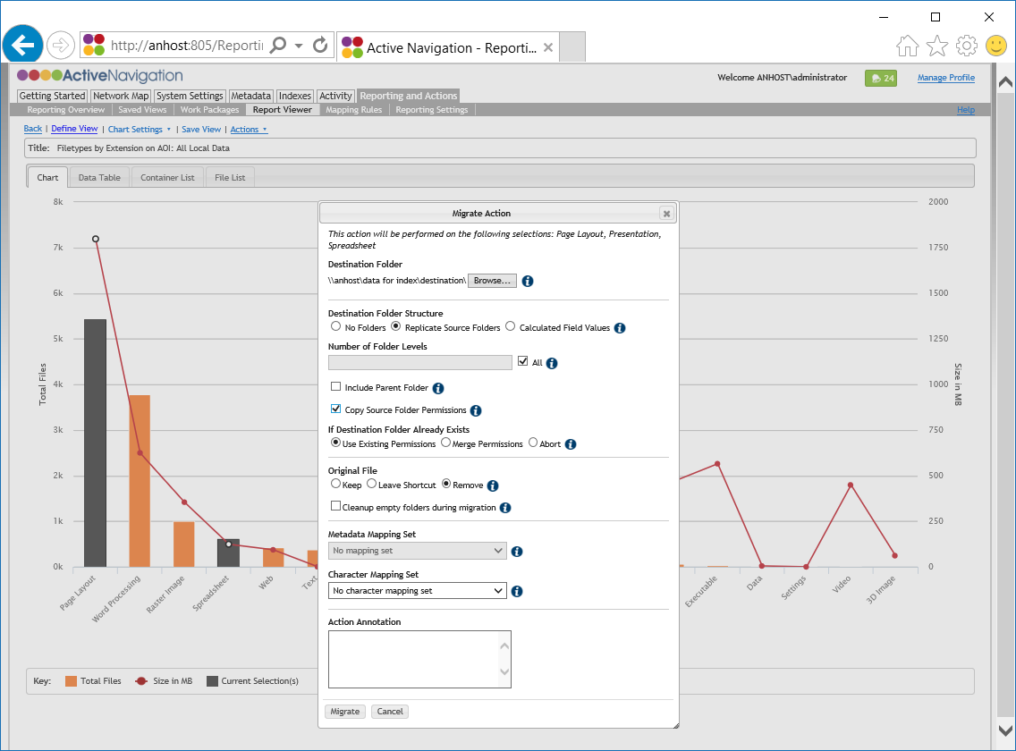
AC3 Migrate Files 2
Click Browse and choose a Destination Folder
Under Destination Folder Structure, click the required option
  No Folders migrates files to a single ‘big bucket’
  Replicate copies the existing structure
  Calculated Field Values uses metadata to build a new structure
Choose an Original Files option
  Keep retains the original in place
  Leave Shortcut creates a Windows shortcut in place of the original file
  Remove deletes the original file
Click Migrate
A confirmation dialog will appear. To confirm the action click OK

Slide 28


AC3 Migration: Destination Structure
Migrate with no structure
Migrate with replicated structure
Migrate with metadata based structure
Source location
Destination location
Destination location
Destination location
A completely new structure is built from values in chosen field
Files are moved to news folders according to their metadata values
Permissions are inherited from the destination
Existing folders are copied across and merged with those in place
Optionally, a number of folders are removed from bottom up
Folder permissions can be copied or merged across
Files migrated to destination with no structure
Permissions are inherited from the destination

Slide 29
Duplication
Analysis to identify duplicate files takes time and is often done after other clean up and deletion work is completed
Work with your Active Navigation Administrator to have duplicate analysis completed for your review

Slide 30
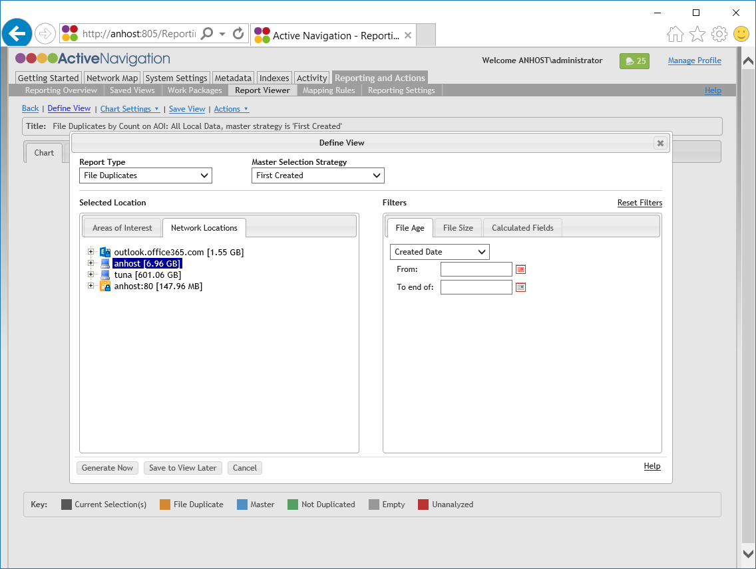
RP2 Generate a Duplicates Report
Go to Reporting and Actions > Report Viewer
Click Define View
From the Report Type drop down, click File Duplicates
From the Master Selection Strategy drop down, click First Created
Click on the Network Locations tab select a location to report on
Click Generate Now

Slide 31
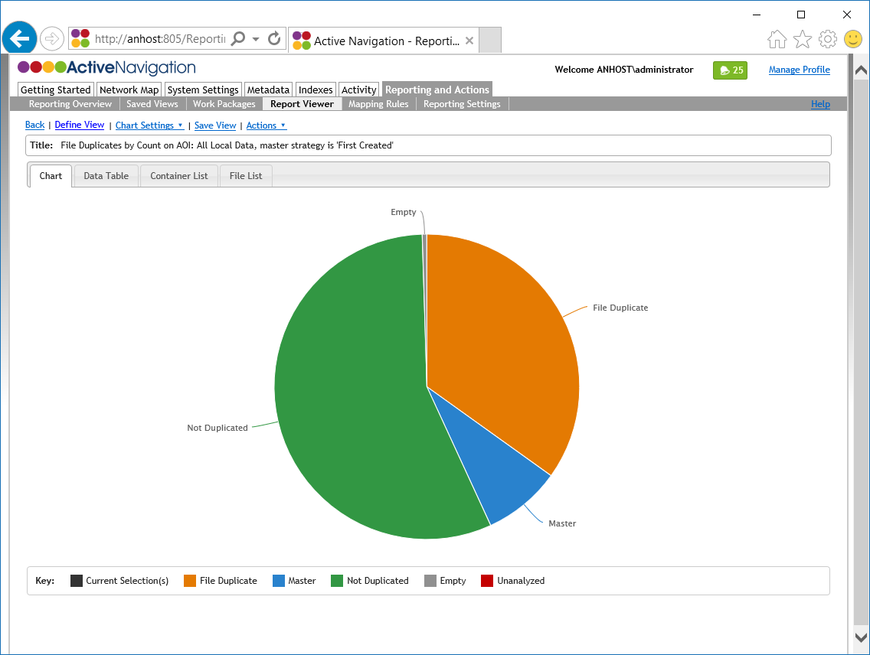
RP2 Review a Duplicates Report
Master shows files in each cluster that match the chosen Master Selection Strategy
File Duplicate shows files for which an identical Master has been identified
Empty files have no size and therefore cannot be analyzed as duplicates

Slide 32
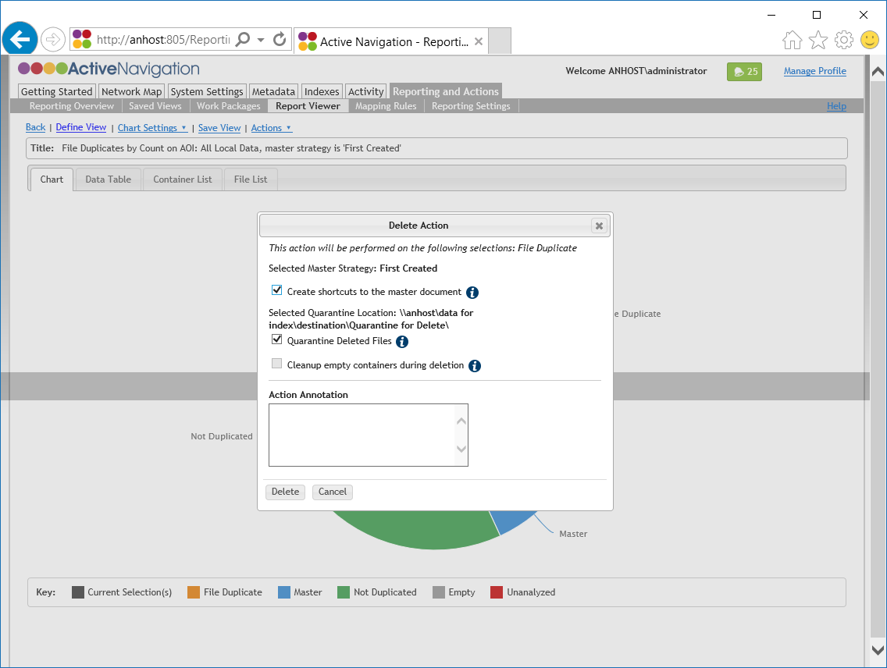
AC2 Delete Files (Duplicates)
When working with a duplicates report additional options are available
The Create Shortcuts option writes a Windows shortcut file in place of the deleted file
The shortcut will point to the remaining master file

Slide 33
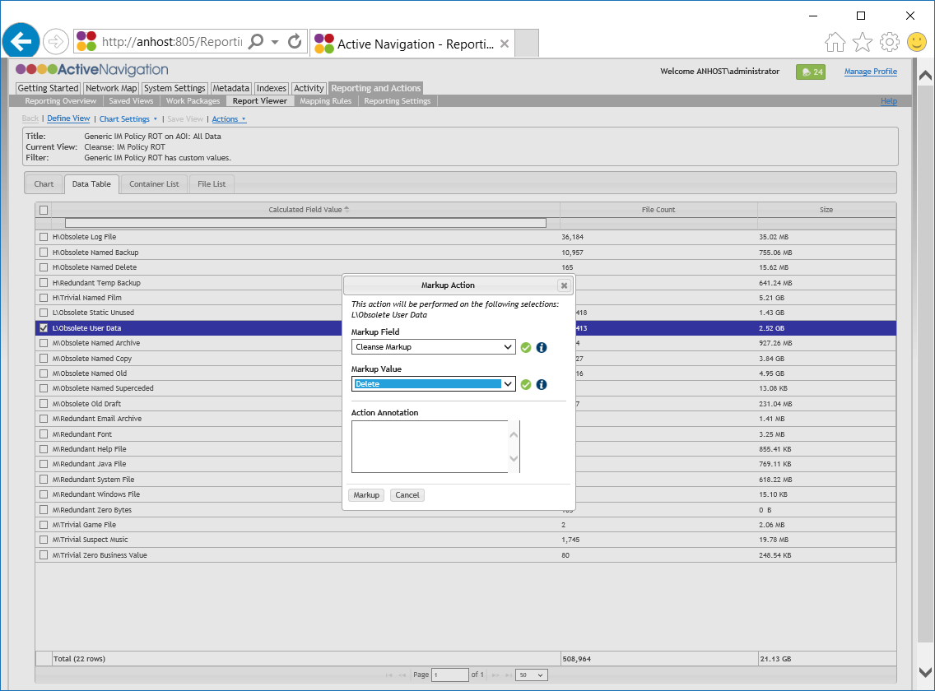
AC4 Markup Files in Bulk
Load a report view for review
Click the Data Table tab
Click on a report value to select files for markup
Right-click and select the Markup option
Select the markup field you wish to store the results in
Select the appropriate markup value
Click Markup
A confirmation dialog will appear. Check the details and click OK to confirm the action.

Slide 34
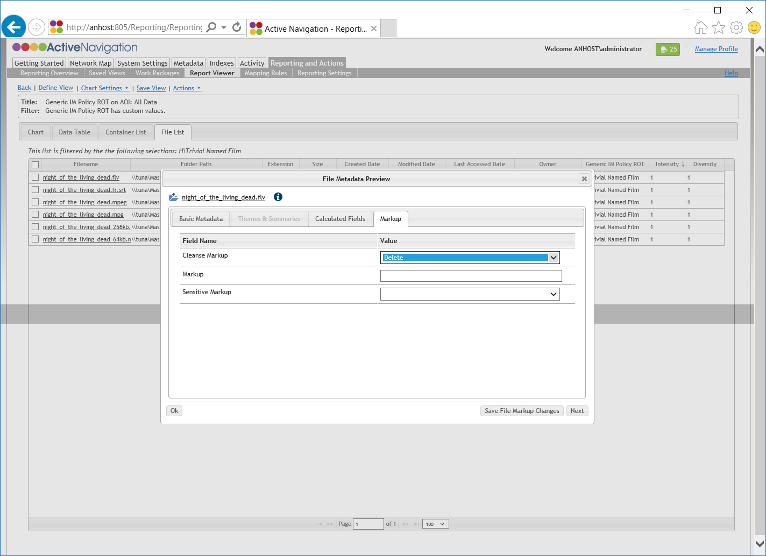
AC4 Markup Files Individually
Load a report view for review
Click on a report value to select files
Click on the File List tab
Click on the name of the first file for review
A metadata preview dialog will be displayed. Click on the Markup tab
Select the required markup values
Click Save File Markup Changes
Click Next to review the next file in the list
Repeat steps to review and markup all files

Slide 35
Reviewing New Metadata
Once unwanted files have been deleted or quarantined and duplicates resolved more complex analysis can take place
Work with your Active Navigation Administrator to ensure the right analysis takes place
Analysis and classification generates new metadata for files so that they can be migrated and tagged in new repositories
To ensure new metadata meets business requirements you may wish to review analysis results
Discovery Center supports review using its browser interface or offline review working with exported data
If you choose to work with exported data, any changes you make will be imported back into Discovery Center by your Active Navigation Administrator

Slide 36
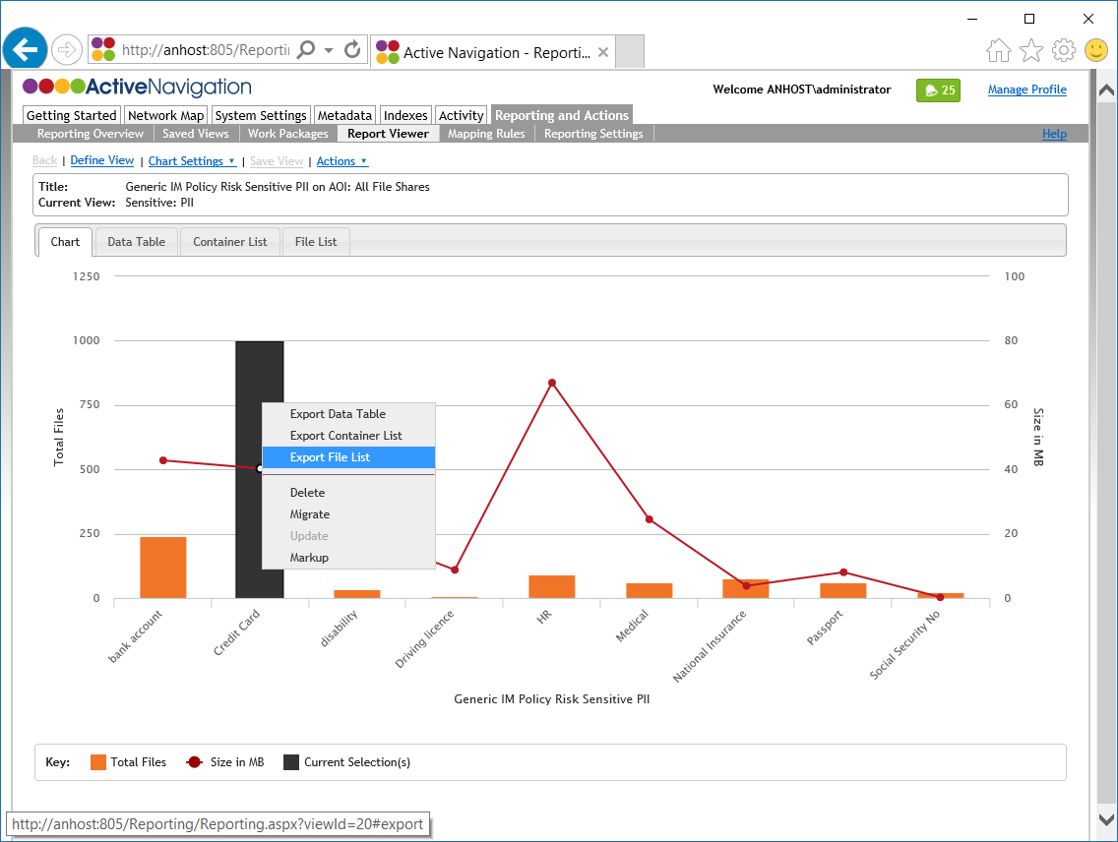
RP3 Export File Level Results 1
Set up a report view to collect the file data for export
From the chart or table, select the report categories for which an export is required
Right-click and click Export File List
An export options dialog will be displayed

Slide 37
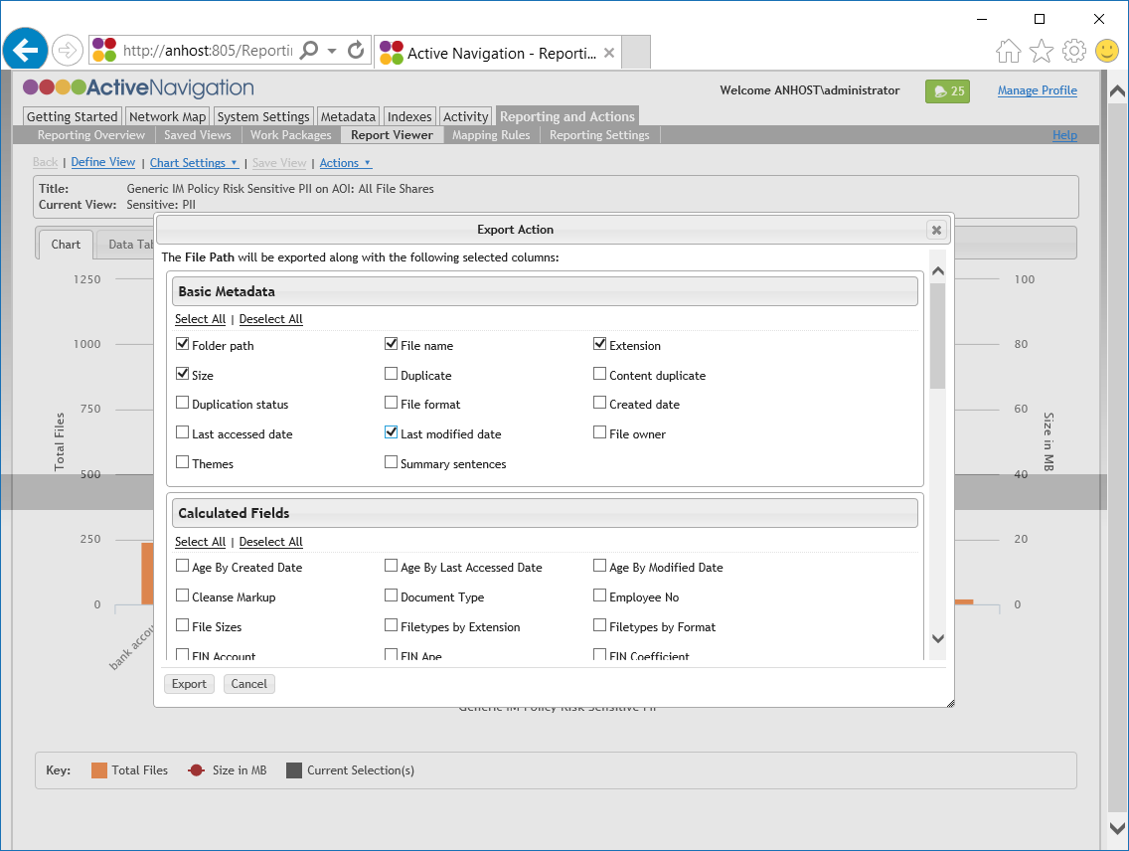
RP3 Export File Level Results 2
Check the metadata fields you wish to export
  File name, folder path, extension, last modified date and size are useful defaults
  Ensure that the fields that must be reviewed are also checked
Scroll to the bottom of the options dialog and ensure that Field Intensity and Field Diversity are unchecked
Click Export
A CSV file will be downloaded to save

Slide 38
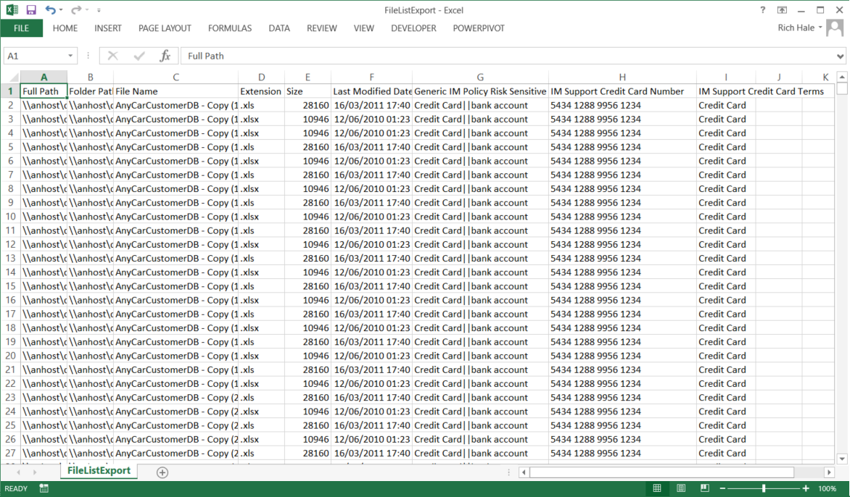
RP3 Review Exported File Data
Exports are readily reviewed in applications such as Microsoft Excel
Excel allows columns to be filtered as needed
If changes are made to export values, Discovery Center is optionally capable of importing those values
When editing exported data
  Do not change Full Path values
  Do not change column headers
  Separate multiple field values using || (eg value A||value B)
Ensure the file is saved as either
  CSV (MS-DOS)
  XLSX workbook
Chosen metadata is presented as column headings
Exported file list always contains full file path

Slide 39
Information Manager References
Related activity modules
  RP1 Basic Reporting
  RP2 Understanding Duplicates
  RP3 Exploring Reporting
  AC2 Deletion and Quarantine
  AC3 Migration
  AC4 Review and Markup
  AC5 SharePoint Actions Features
Related quick start guides
  QS2A ROT Cleansing
  QS2B De-Duplication
  QS3 File Migration to File Share
  QS4 File Migration to SharePoint
  QS5 Policy Monitoring

