Slide 1
Discovery Center Workbench Starter
Creating and Working with Classification Structures

Slide 2
Understanding Discovery Center Workbench
Discovery Center Workbench enables users in the Active Navigation Administrator or Information Manager role to create, edit and test classification structures for file classification and tagging
For users in the Active Navigation Administrator role, Workbench also allows then to upload and deploy classifications to Discovery Center
Classification structures enable files to be classified and tagged against a hierarchical schema such as a file plan, taxonomy or retention schedule
To be deployed, completed classification structures must be
  Uploaded to Discovery Center
  Added to a classification calculated field
  The classification calculated field must then be added to the appropriate index configuration

Slide 3
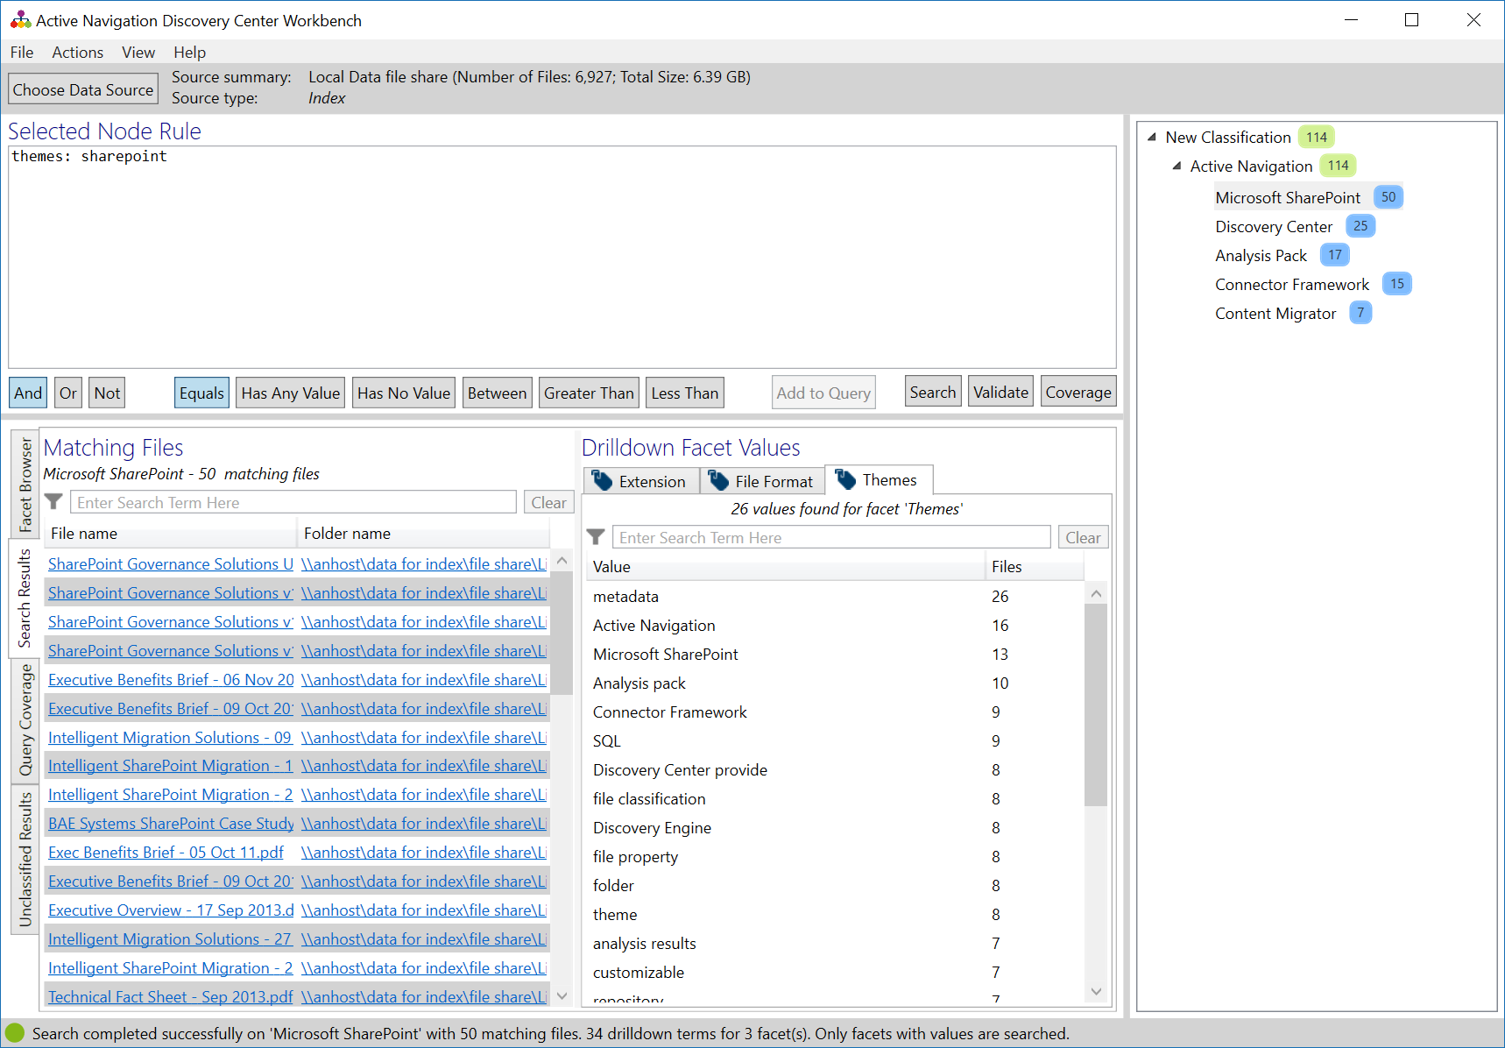
MD2 About Discovery Center Workbench
Discovery Center Workbench is a Windows application
Workbench connects to a Discovery Center server to
  Load and explore facets from indexes
  Create classification structures from facets
  Test classification structures on index results
  Upload classification structures to and download from Discovery Center
Workbench can be used by users in the following roles
  Active Navigation Administrators
  Information Managers
Classification node
Classification node rule
Classification structure
Test results

Slide 4
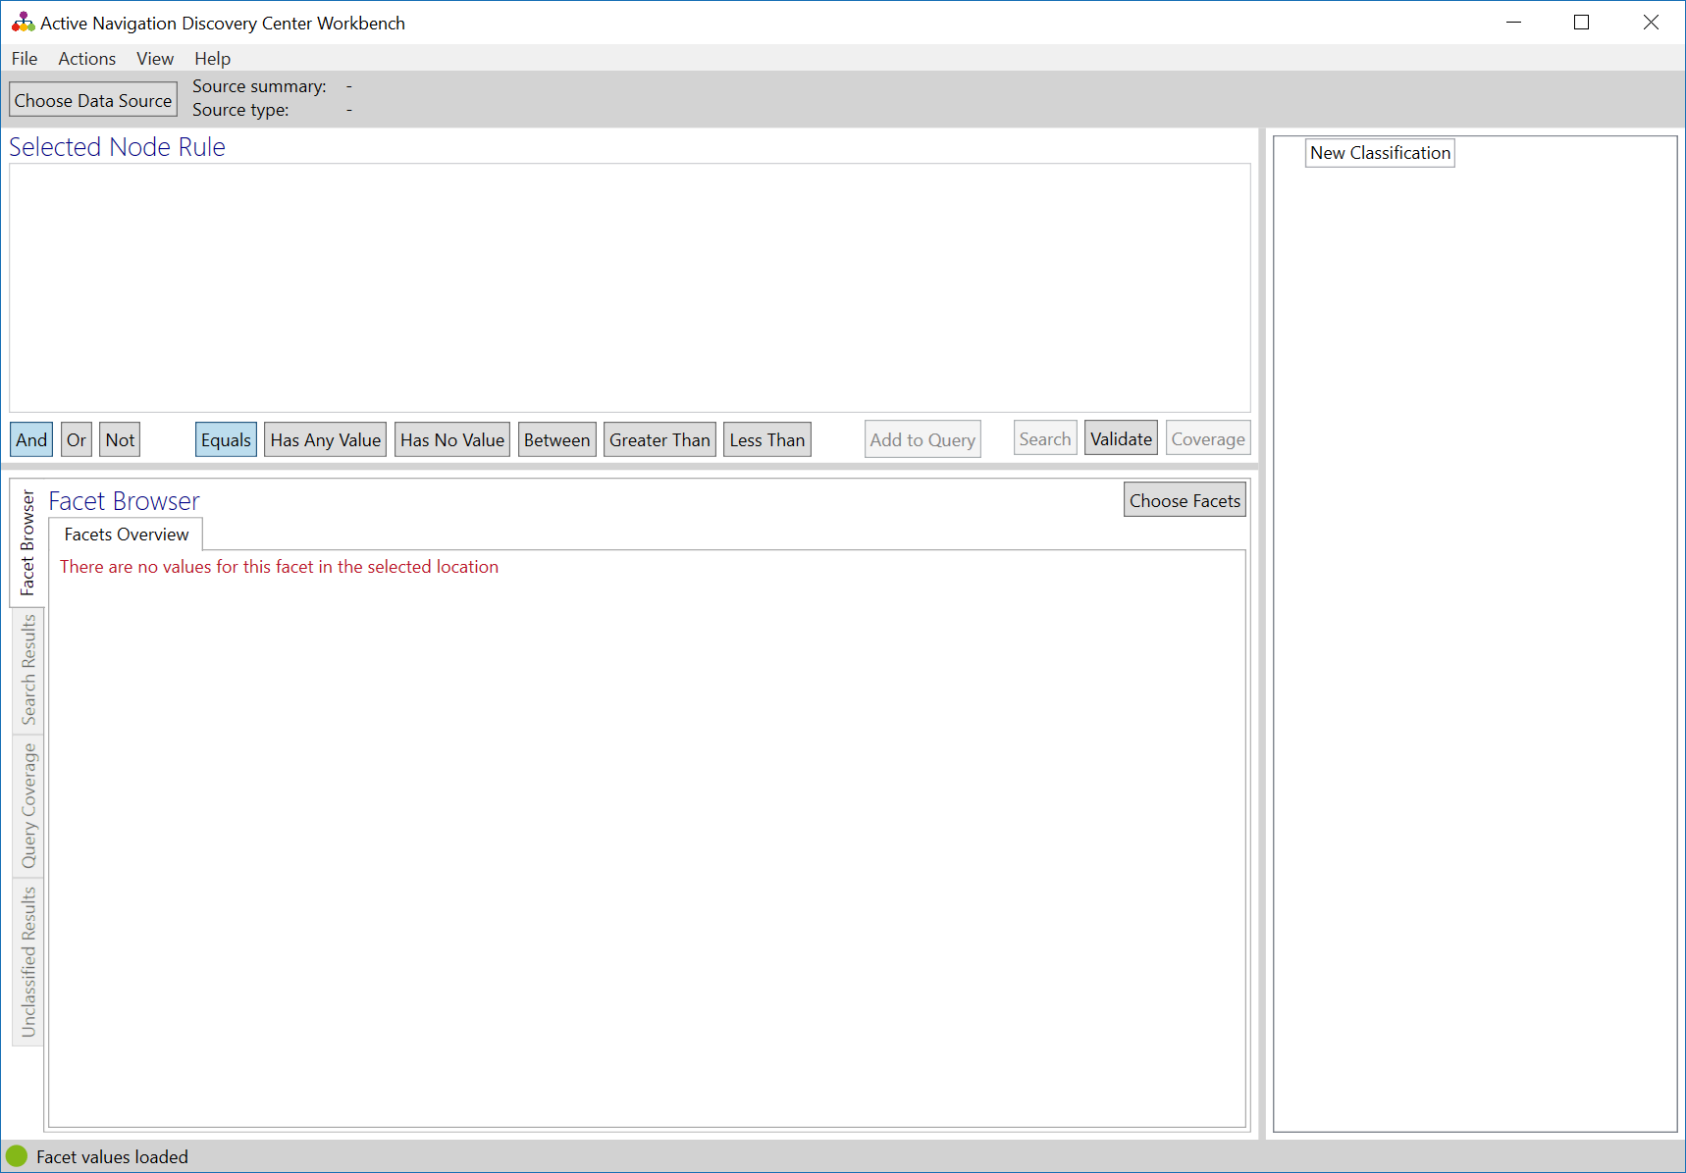
MD2 Start Discovery Center Workbench
Open the Discovery Center Workbench Application
  Go to Start and search for Discovery Center Workbench
  Locate the Discovery Center Workbench under Active Navigation start folder
On start Workbench will request server connection details
  Enter your Discovery Center URL and click okay
  When challenged, enter the credentials for your Discovery Center user role
Workbench will open ready for configuration

Slide 5
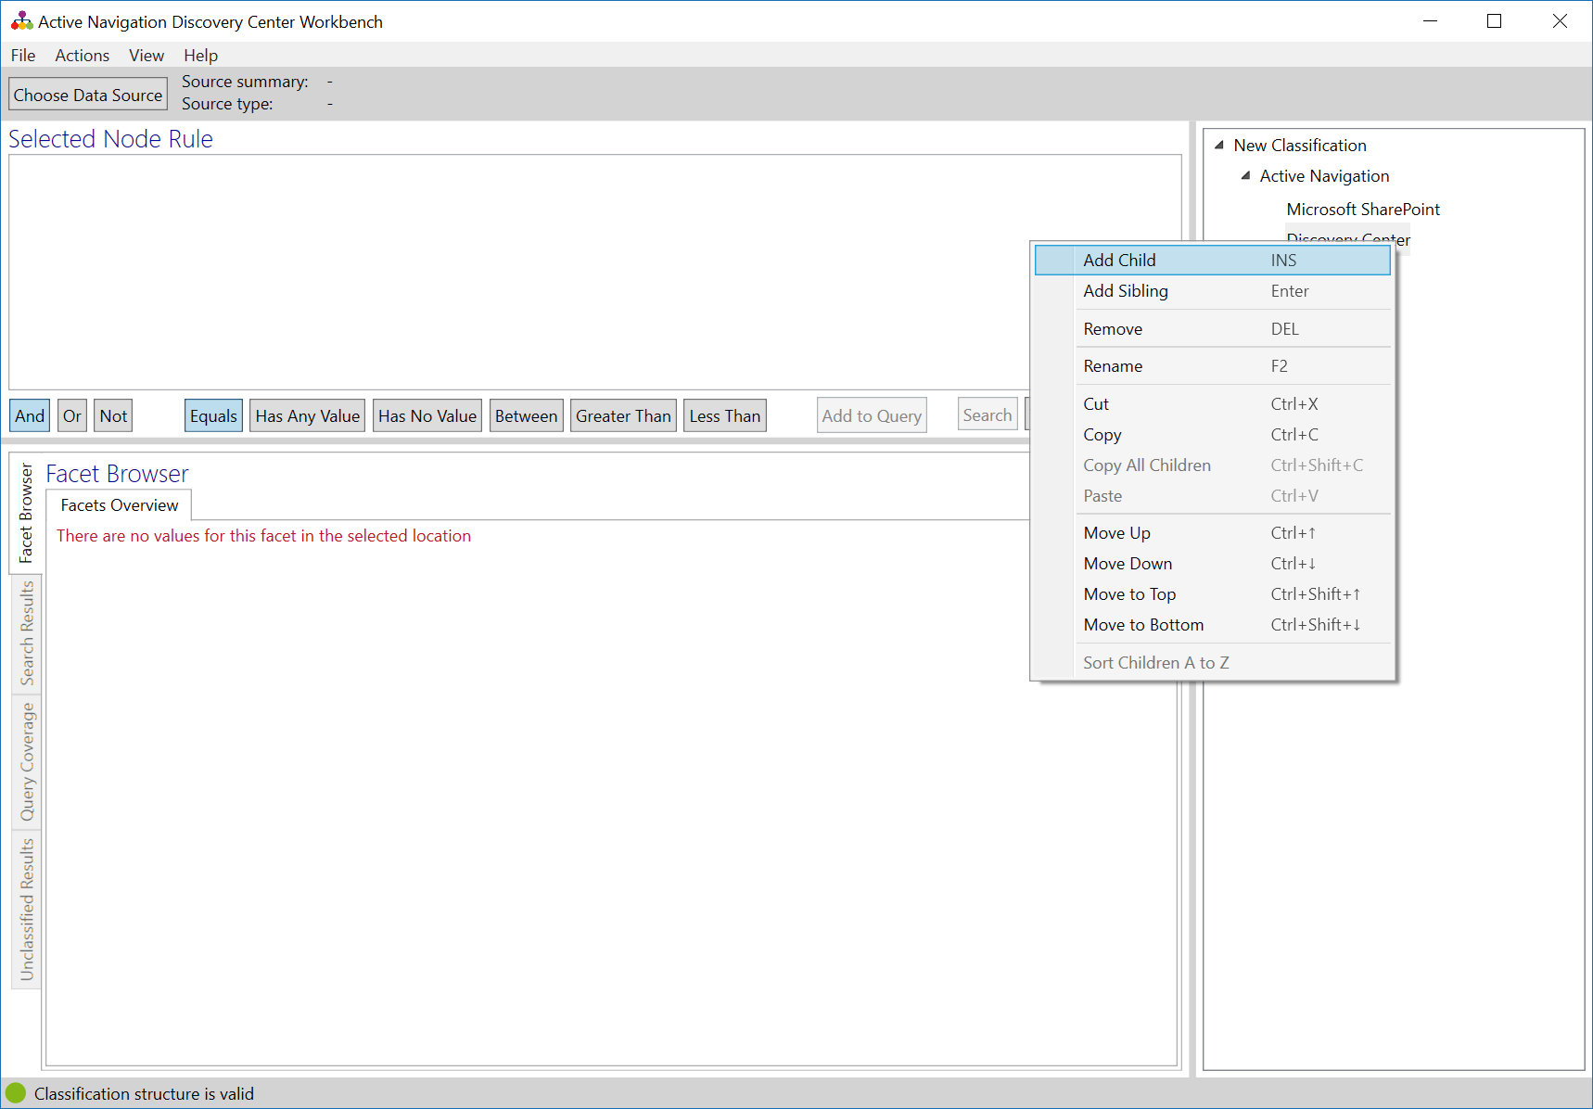
MD2 Create a New Classification Structure
On start, Workbench will display the default node New Classification
Right-click on the default node
  Click Rename
  Enter a new name for the node
  Press Enter
Right-click on the default node
  Click Add Child
  Enter a name for the new node
  Press Enter
Right-click on the newly added node
  Click Add Sibling
  Enter a name for the new node
  Press Enter
Add new nodes as needed

Slide 6
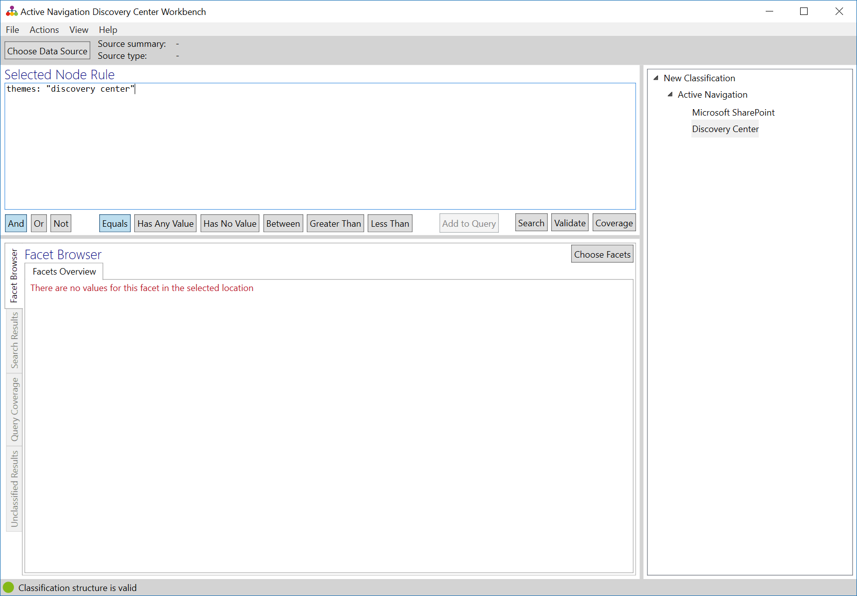
MD2 Add a Node Rule
Click on the node to which you wish to add the new rule
Click in the Selected Node Rule text box
Enter the rule
  A rule consists of one or more facet names, each followed by a colon and a value, enclosed in quotes
  Each facet must be separated by a suitable Boolean operator
Click Validate to check the rule syntax
Click on another node and repeat to add more rules
Click File > Save Classification to create a classification file and save your work
themes: “discovery center"
Selected node

Slide 7
MD2 About Node Rules
Facet
Facet value
Boolean operator
Node rules can be simple or very complex
Facets describe what file attributes are relevant
  Facets are entered in lowercase without spaces
  Facet values are quoted precisely, within brackets for multiple value terms
Boolean operators direct how the rule behaves when facet values are matched
  Boolean operators are entered in CAPITALS (AND, OR, NOT)
Any one rule may contain no more than 1024 discrete facet values
extension: (.boe OR .box OR .mbox OR .mbs OR .mbx OR .mmdf OR .msf OR .nsf OR .ost OR .pst OR .tbb)
Facet
Facet
Facet value range
((folders:archive OR filename:archive) AND age_by_modified:[365 TO 99999999]) NOT (filename:"Do not delete" OR folders:"Do not delete")
Facet value
Facet

Slide 8
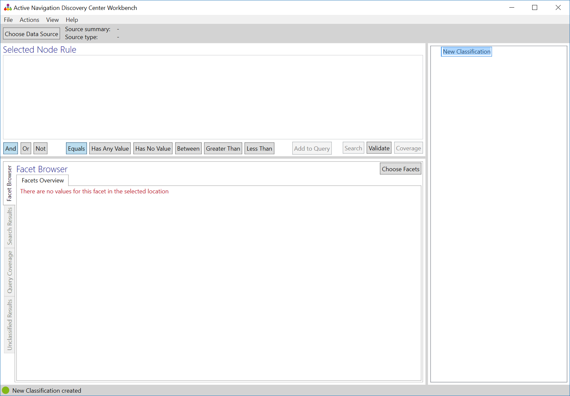
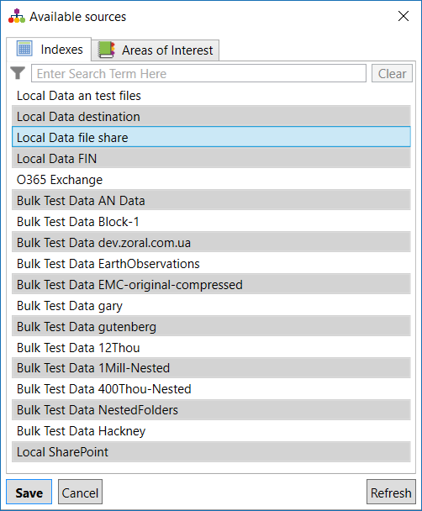
MD2 Choose a Data Source
In Discovery Center Workbench click Choose Data Source
  The Available sources dialog box will appear
  Data sources are either indexes or areas of interest
Click on an Index or Area of Interest
Click Save
The chosen Index or Area of Interest will be shown in the top status bar

Slide 9
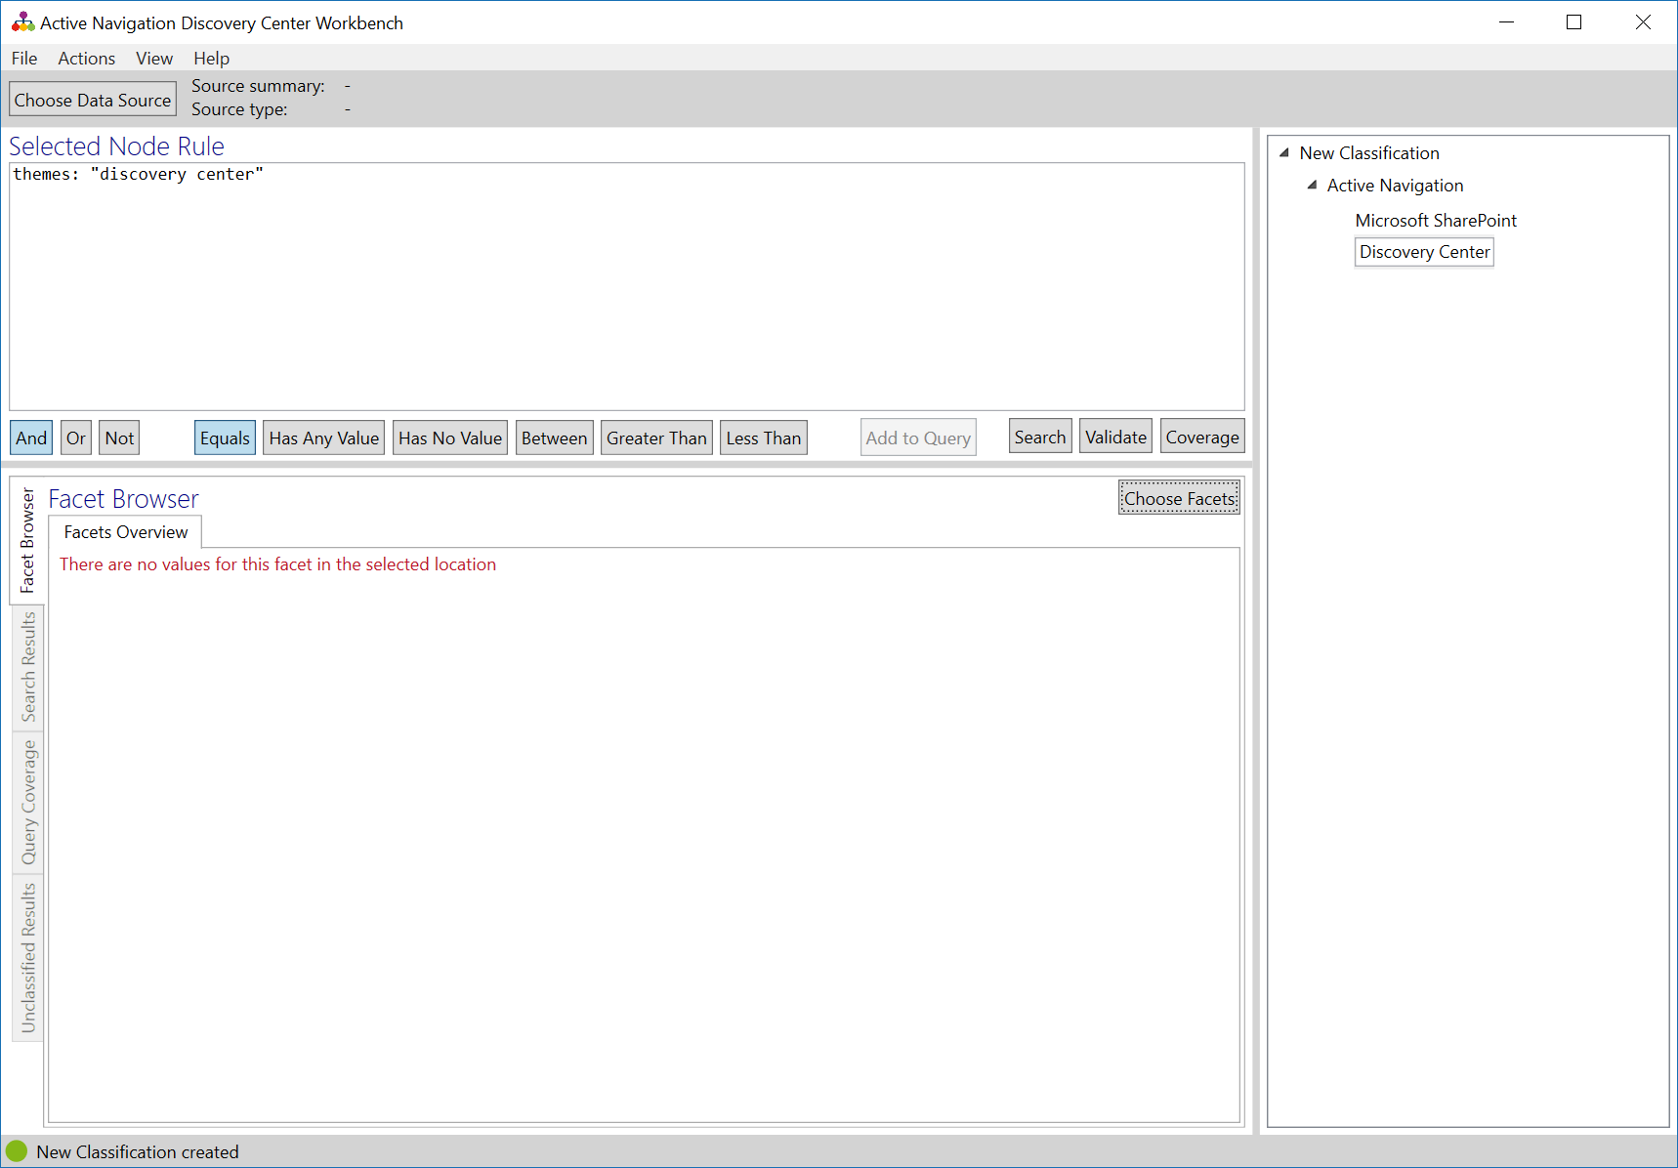
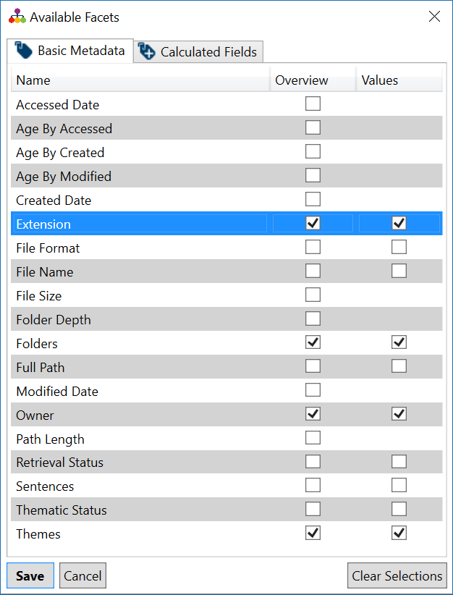
MD2 Selecting Facets
Discovery Center provides a wide range of facets
  Basic metadata is always available
  Calculated fields are optional facets
Workbench Help provides details
Click the Facet Browser tab and click Choose Facets
  The Available Facets dialog shows all basic metadata and calculated field facets
  Select the Values checkbox for a facet to download its values from the chosen data source
Click Save
Workbench will pause whilst facet values are downloaded

Slide 10
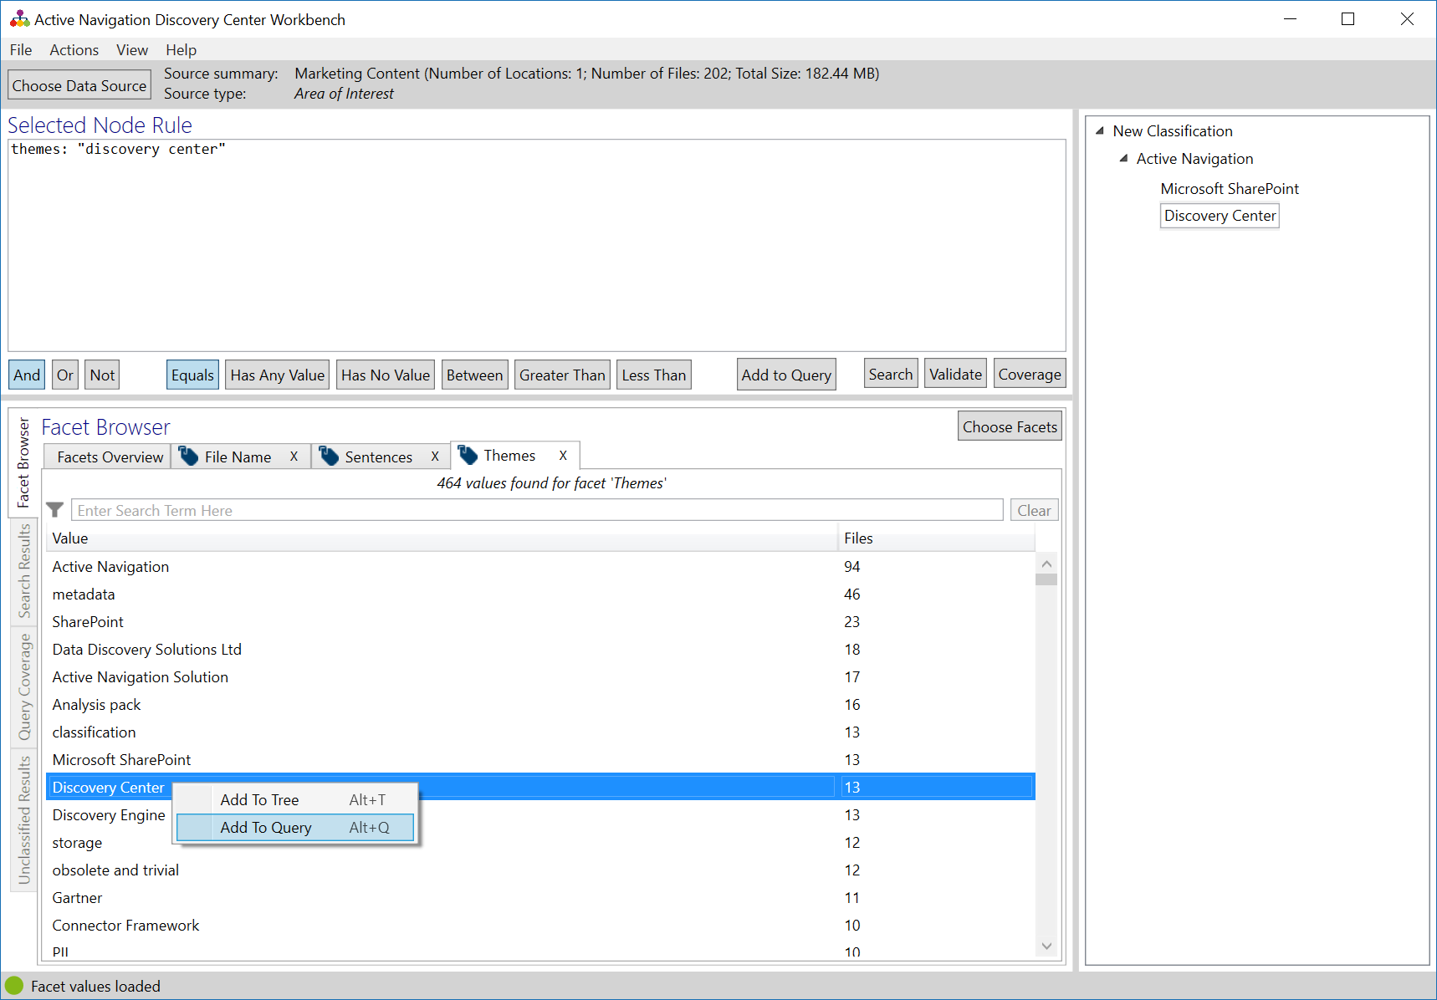
MD2 Working with Facets
Click on the Facet Browser side tab
Click on the facet tab you wish to work with
  The facet tab shows values and the number of matched files
To add a node using a facet value
  Right click on the facet value
  Click Add To Tree
  A node and rule will be created
To add the value to an existing node
  Click on the node name
  Click on AND, OR or NOT operator
  Right click on the facet value
  Click Add to Query
Repeat as necessary

Slide 11
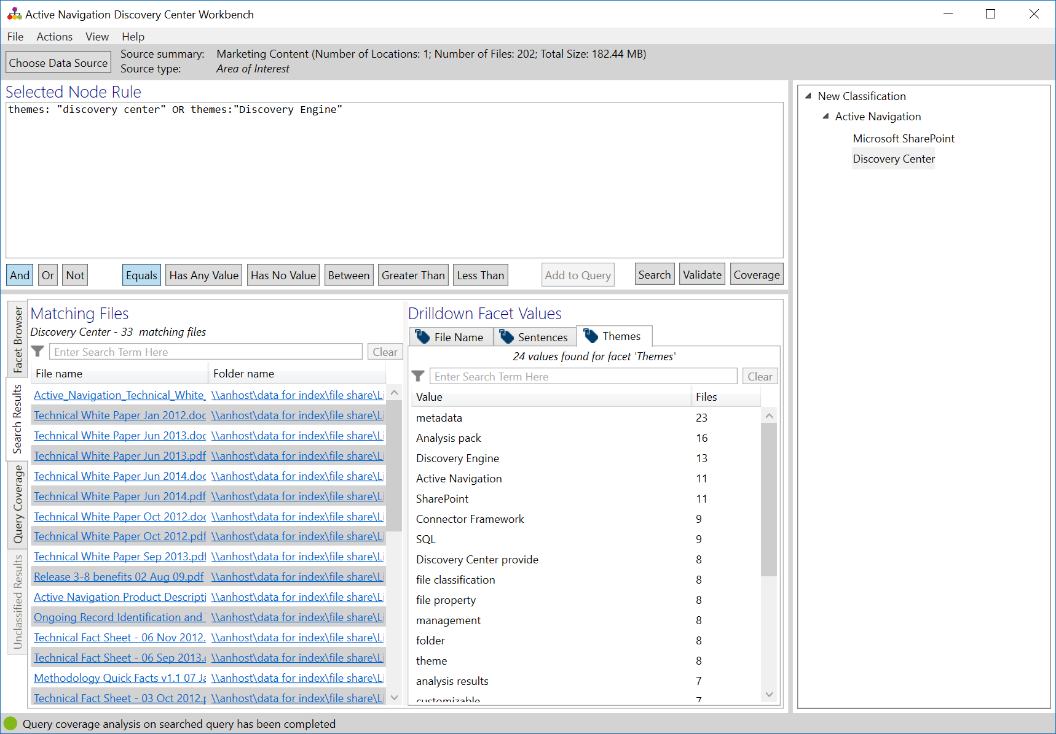
MD2 Test a Node Rule
Click on the node you wish to test and click Search
  Workbench will query the data source for matching files
  Search results will be displayed
  Search across large data sources takes time to execute
Scroll through search results to check the right files have been returned
  To remove incorrect files
    Add new AND terms
    Remove unnecessary OR terms
  To return more files
    Remove unneeded AND terms
    Add new OR terms
Repeat this process to build out an initial set of node rules
These files match the node rule

Slide 12

MD2 Refine Rules Using Drill Down Terms
Drill down terms show how an initial node rule it might be improved
Click on a node and click Search. Drill down facet values are displayed next to the search results
  Each selected facets has a tab
  Each tab shows values from only the files in the search results
Review the drill down facet values
  Add NOT terms to exclude files with unwanted values
  Add OR terms to return additional files with those values
  Add AND terms to make the rule more precise
Repeat this process to improve the results from each node in turn

Slide 13
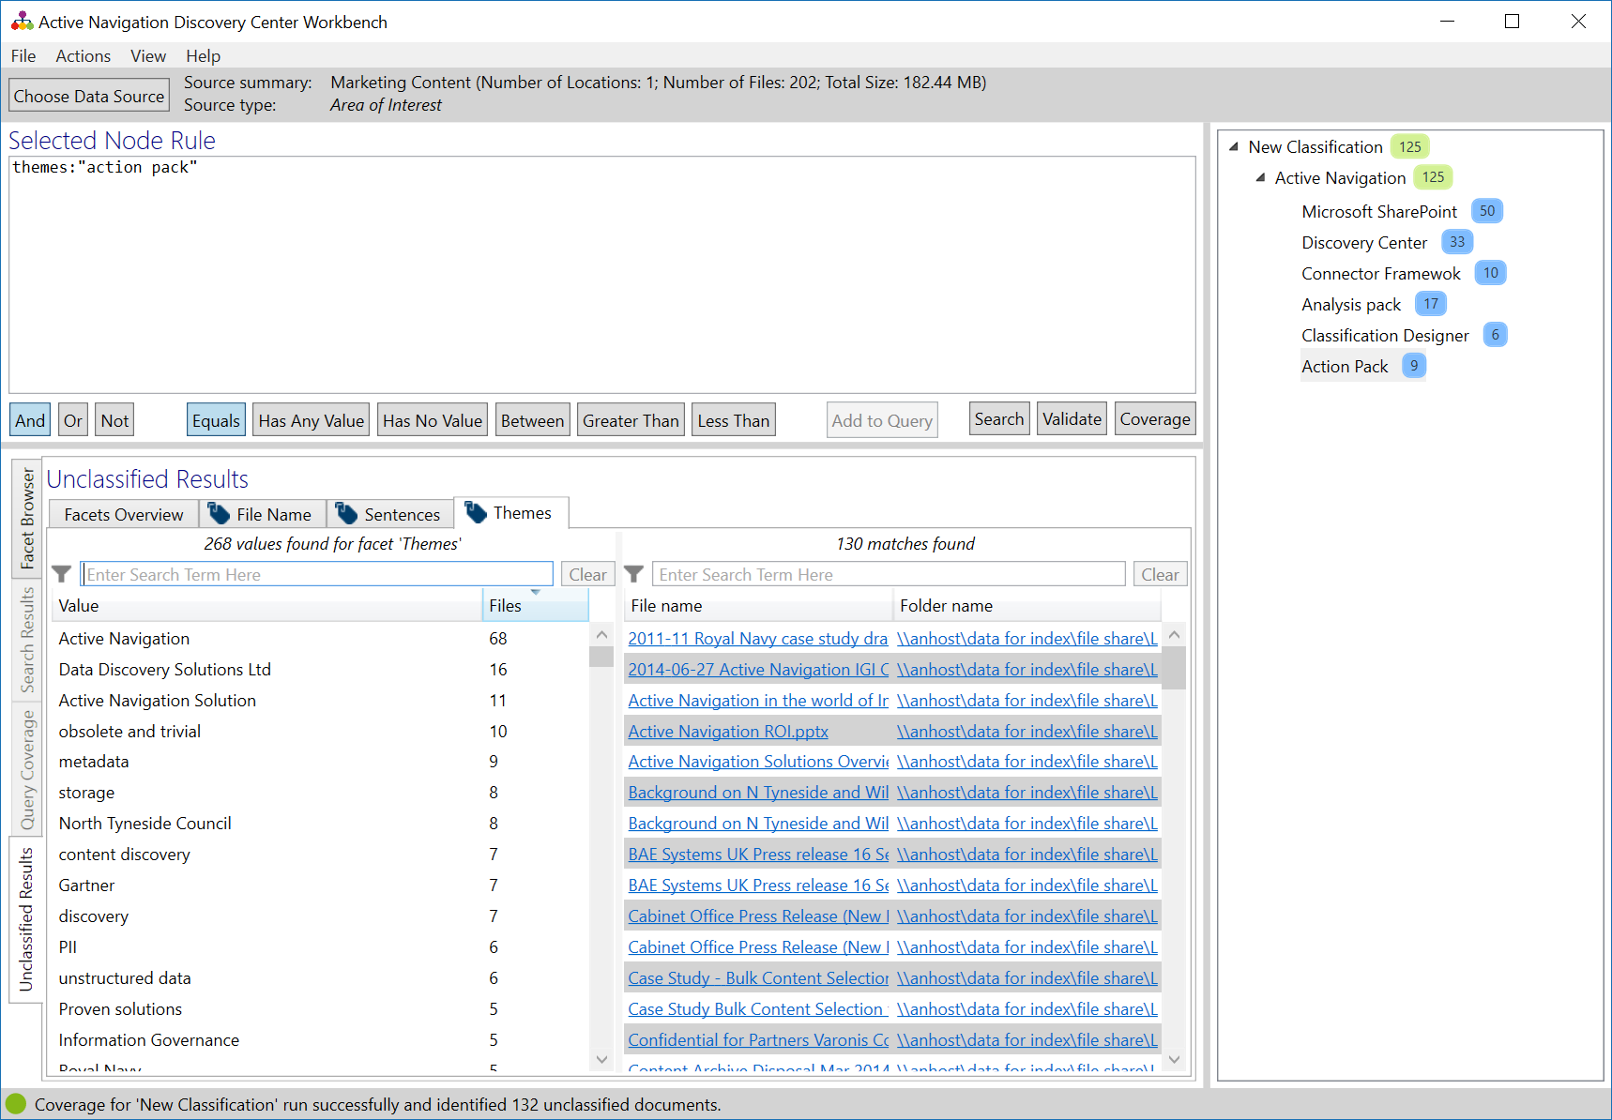
MD2 Test Classification Coverage
With all nodes tested, use coverage to test the whole classification
Click Coverage
  Workbench will query the whole classification
  Complex classification and large data sources will take time to complete
Results are marked against each node
  Blue shows the number of files that match a node
  Green shows the sum of files matched for all child nodes
Unclassified Results shows files not matched in any node
  Use this tab to add more nodes and modify rules to match more files
Sum of matches for child nodes
Matches for this node

Slide 14
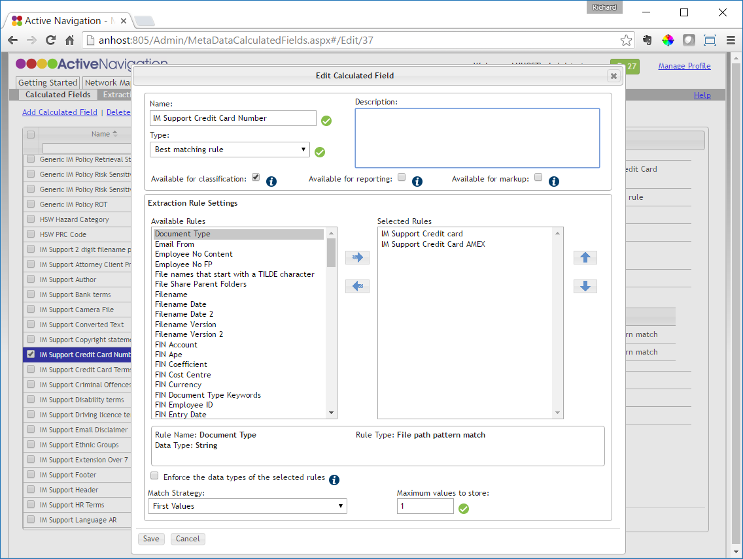
MD2 Understanding Facets
Index configuration for a data source determines which facets are available
  Most basic metadata facets are always available
    Extensions, dates, age, owner, file size
    Folders, file names
  Where analysis has been completed, themes and summaries are available
To use a calculated field facet
  Go to Discovery Center > Metadata > Calculated Fields
  Select the field you wish to use
  Click Edit
  Select the Available for classification check box
  Click Save

Slide 15
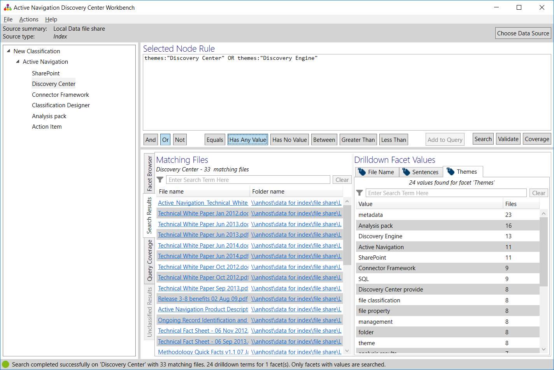
MD2 Special Facets and Operators
Calculated fields provide a ‘has’ query
  credit_card_num: “1234-5678-9876-5432” finds files with a specific credit card number
  has_credit_card_num: true finds files containing any credit card number
  has_credit_card_num: false finds files with no credit card number
A range query can be used to match files with values in a specific range
  age_by_modified:[28 TO 999999] matches files with an age older than 28 days
  filesize:[0 TO 1000000000] matches files with size less than 1GB (1000,000,000 bytes)
Workbench provides shortcut buttons for these operators

Slide 16
MD2 Example Node Rules
Purpose | Rule | Notes
To match files with a file extension from a given list | extension: (.boe OR .box OR .mbox OR .mbs OR .mbx OR .mmdf OR .msf OR .nsf OR .ost OR .pst OR .tbb)
To match files between two modified dates | modified_date:[20081010 TO 20100131] | You must use international date convention YYYYMMDD
To match files within a size range, eg up to 1GB | filesize:[0 TO 1000000000] | Sizes are captured in bytes. 1,000 = 1KB, 1000,000 = 1MB, 1000,000,000 = 1GB
To match text from a file name | filename:("any text" OR "words" OR "match a phrase") | Single terms do not need quotes
To match text from a folder name | folders:("any text" OR "words" OR "match a phrase") | Single terms do not need quotes
To match a calculated field facet that has any value | has_social_security_number:true | Use "has" in front of any calculated field name. Always use lower case text and replace spaces with underscores

Slide 17
Important to Remember
Classification relies on a chain of events. When using classifications make sure you have completed the steps below
  Upload the classification to Discovery Center so it can be used
  Add the classified to a classification calculated field to capture the results
  Add the calculated field to an appropriate index configuration to determine where it is used
  Re-classify the relevant indexes to populate the results
If results don’t appear as expected, review the above steps and ensure they have been followed
Other references
  The Creating Custom Metadata Starter provides an overview of the above tasks
  Training module MD2 provides more in-depth details on classification

